Slide 1
Rising Tension: WWII Begins

Slide 2
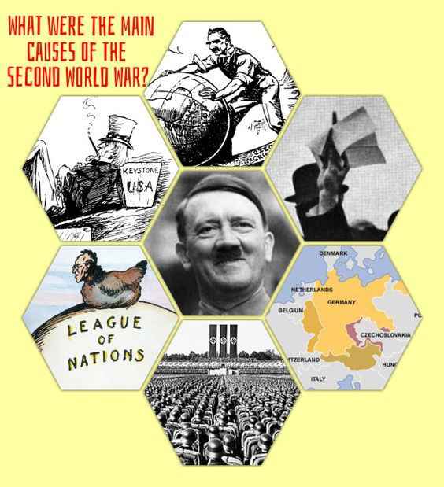
There was a rise in Fascist dictators.
Germany took the blame for WWI in the Treaty of Versailles and struggled economically for it.
The U.S. wanted to stay out of world issues.
The U.S. adopted a policy of Isolationism and did not join the League of Nations.
Hitler invaded Austria and the League of Nations did nothing, so he invaded Czech.
The Nazi Party, Nationalism, & Militarism grow.

Slide 3
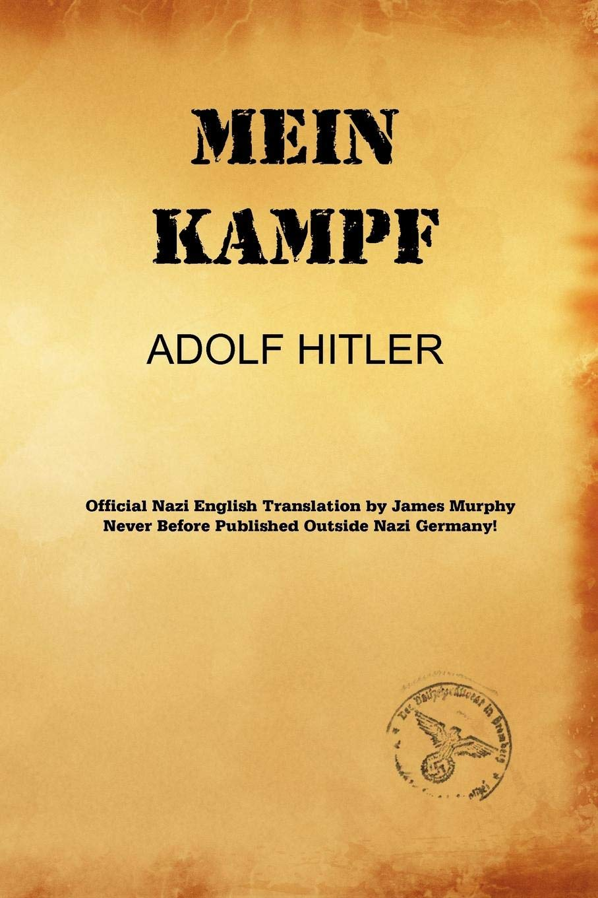
Hitler’s Rise to Power
Benito Mussolini forms the National Fascist Party in Italy. Its success will be a huge influence on Hitler.
Hitler joins the German Worker’s Party and stages a failed coup. He goes to jail for 5 months and writes “Mein Kampf,” which means “My Fight.” This outlined his plan for Germany and his antisemitic views.
Hitler rises in popularity and becomes chancellor and president. He is a very powerful and convincing speaker.
https://www.youtube.com/watch?v=jFICRFKtAc4&feature=youtu.be
https://www.youtube.com/watch?v=FJ3N_2r6R-o

Slide 4
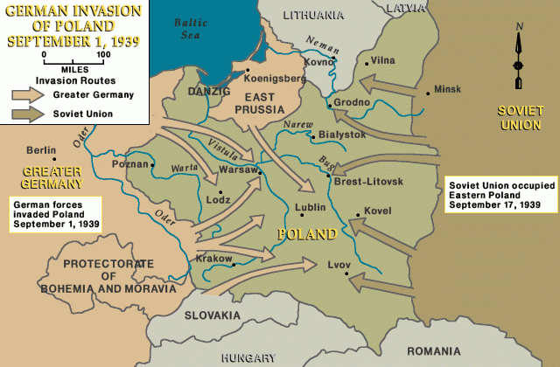
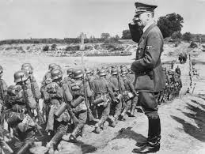
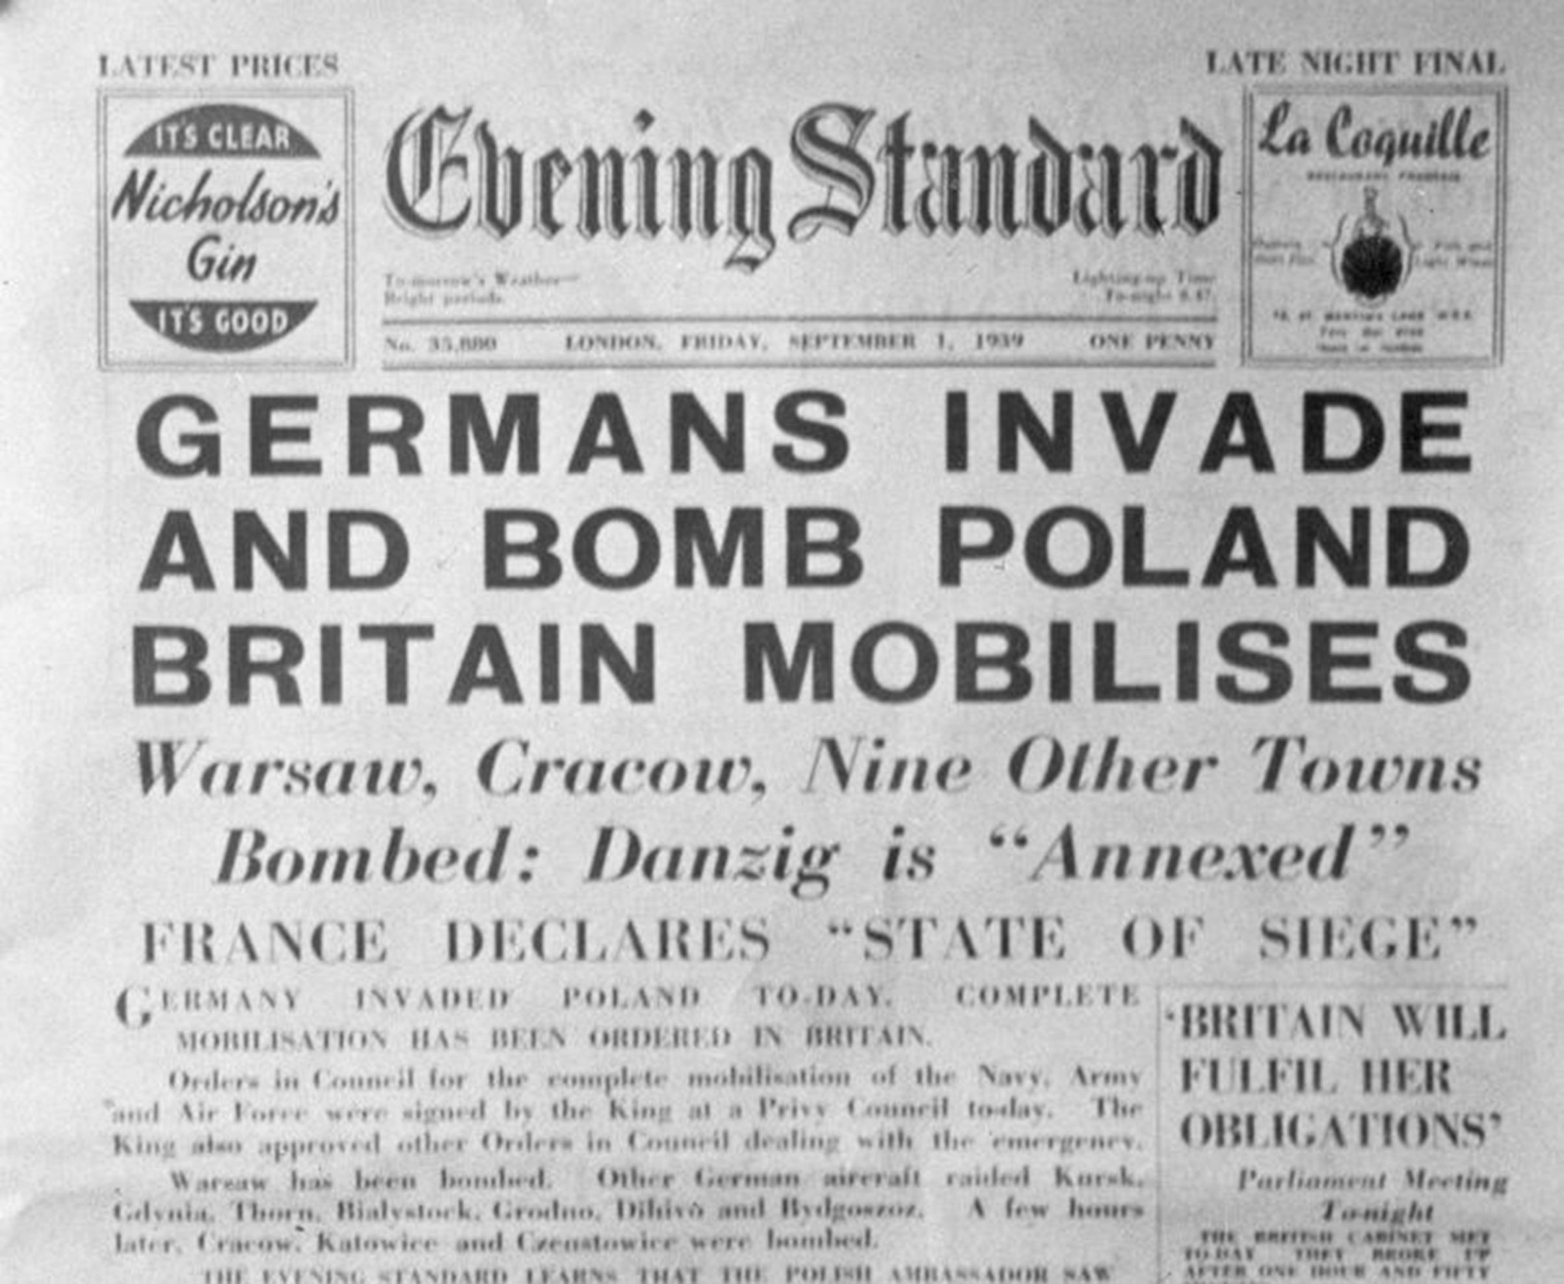
WWII officially Began when Hitler Invaded Poland in 1939.
https://www.youtube.com/watch?v=PCXSuaOozDE

Slide 5
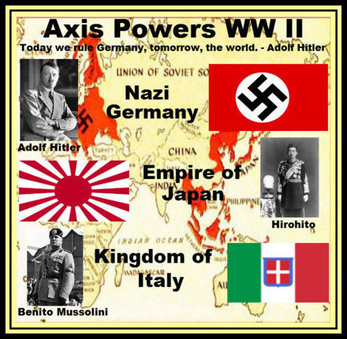
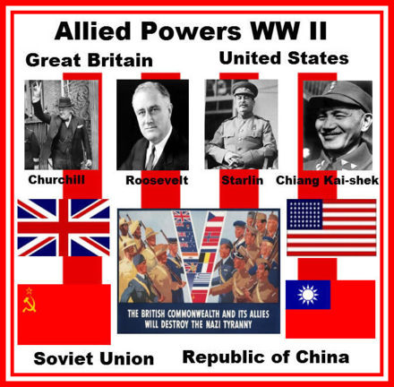
Countries involved in WWII
AXIS POWERS
ALLIED FORCES
NOT AT FIRST!

Slide 6
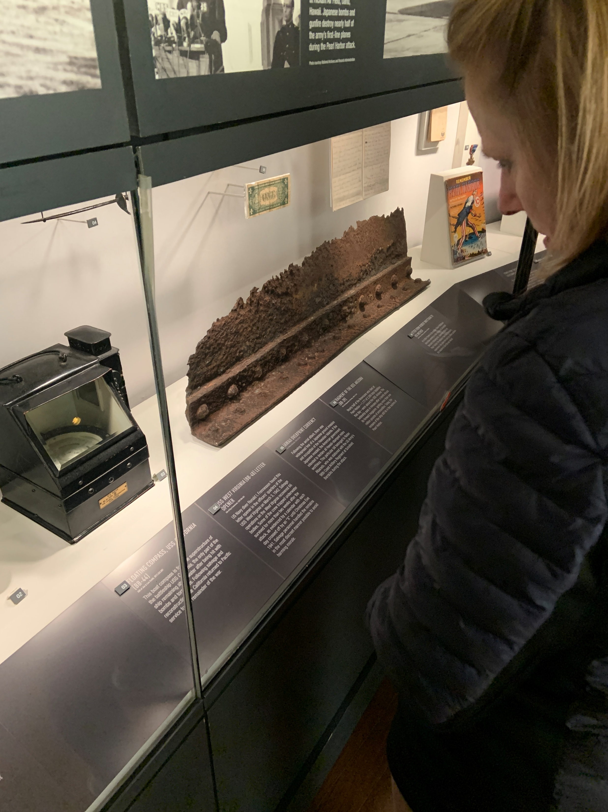
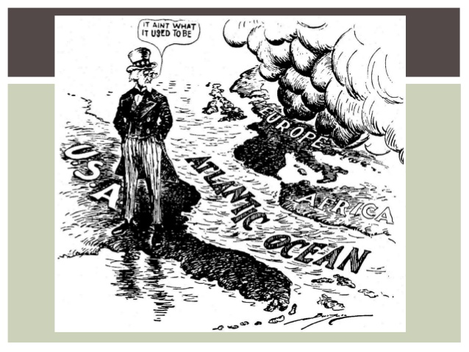
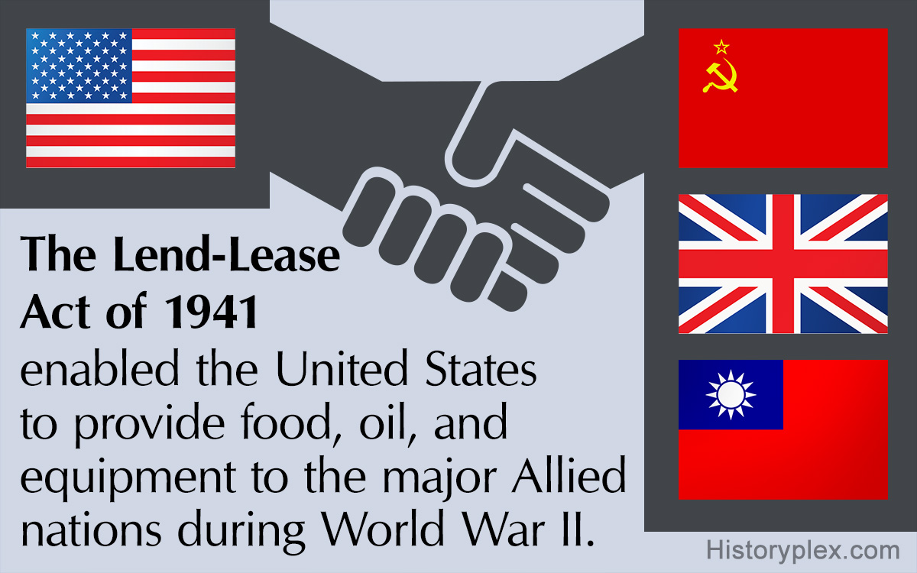
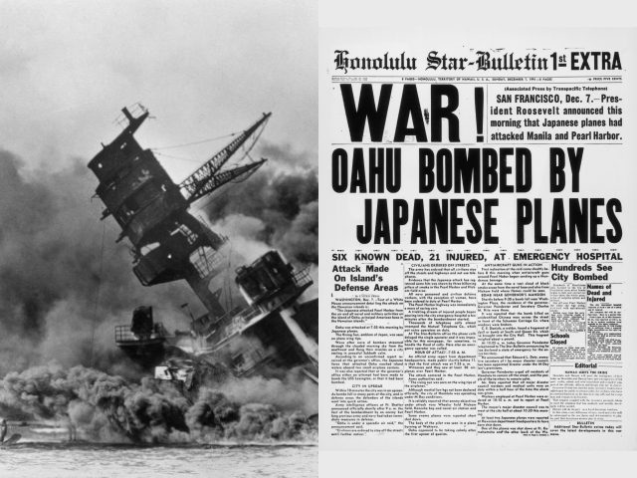
U.S. Involvement At The Beginning of WWII
Isolationism- U.S. wanted to stay out of foreign affairs.
Lend/Lease Act- They sent supplies and aid to Allied troops, but did not directly get involved in the war.
U.S. position changes on Dec. 7, 1941 when Japan bombs Pearl Harbor, Hawaii.
Causes- U.S. sanctions and oil embargo on Japan, U.S. against Japan’s attack on China, control of East Asia
U.S. responds by declaring war on Japan and enters WWII.
https://www.youtube.com/watch?v=lK8gYGg0dkE

Slide 7
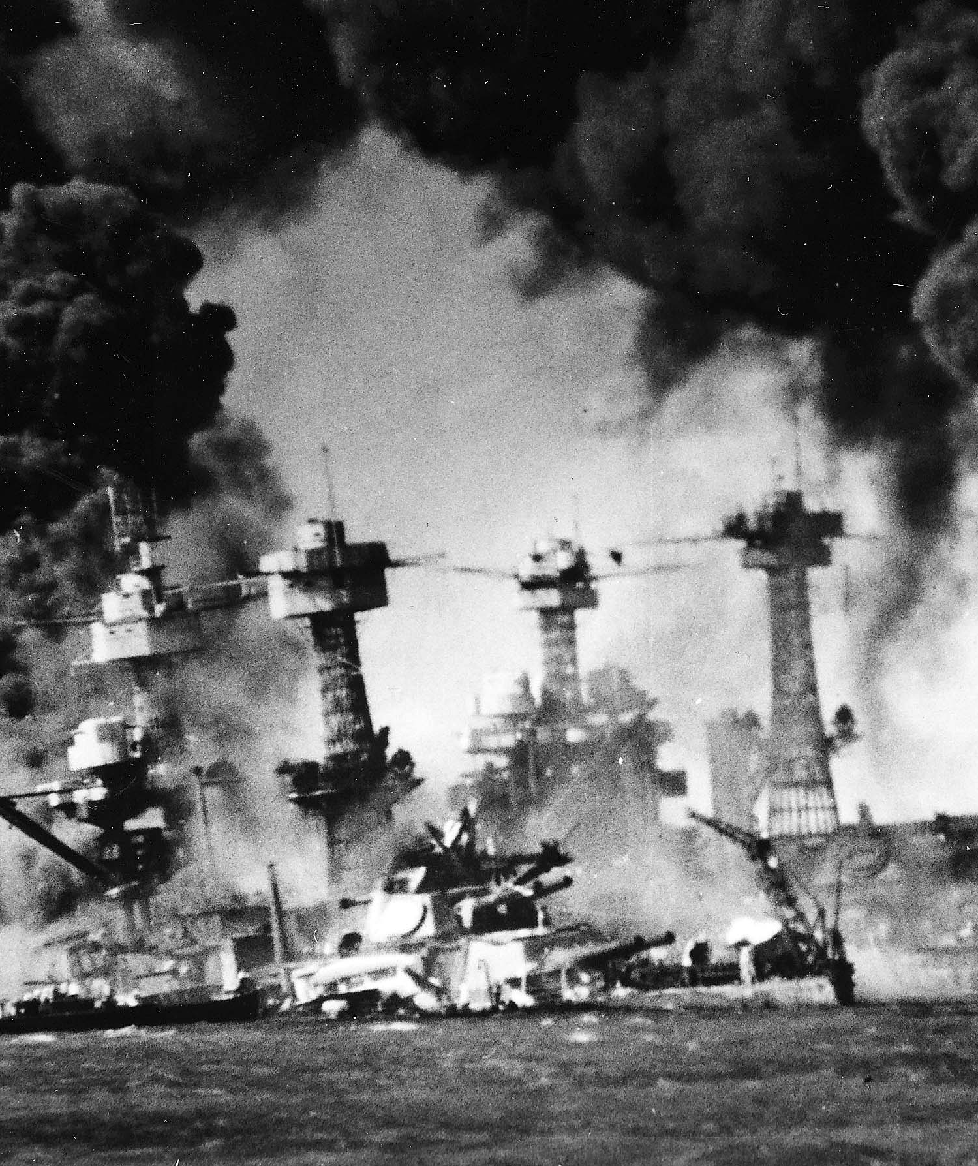
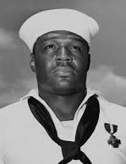
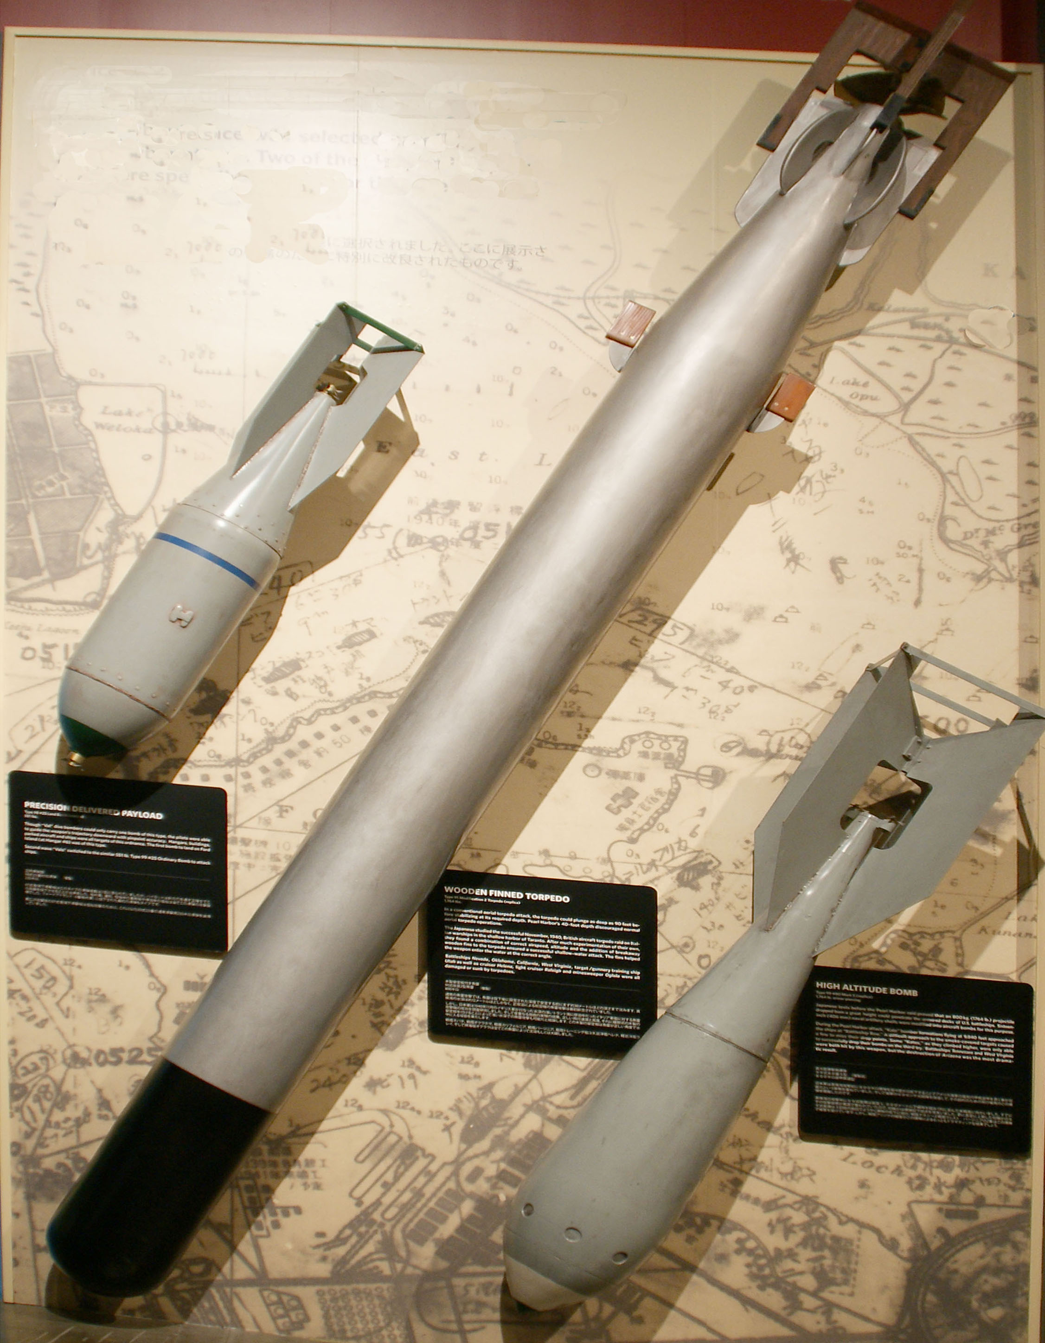
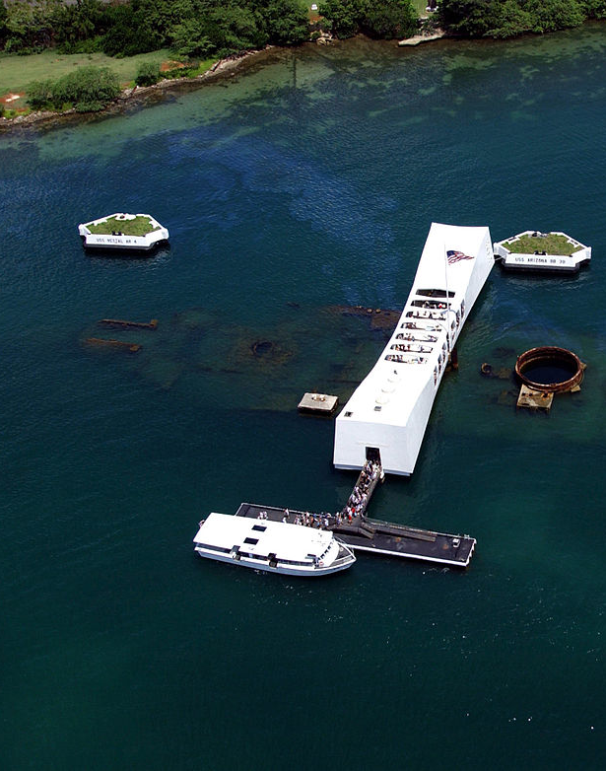
December 7th, 1941- Japanese Attack on Pearl Harbor
-Japanese planned attack for weeks hoping to catch U.S. by surprise.
-They damaged all naval battleships in the harbor, killing 2,400 Americans.
-THREE DAYS BEFORE THE Dec. 7, 1941 Japanese attack on Pearl Harbor, President Roosevelt was warned in a memo from naval intelligence that Tokyo's military and spy network was focused on Hawaii.
Battleship Arizona
Doris "Dorie" Miller was an American sailor in the United States Navy. He manned anti-aircraft guns during the attack on Pearl Harbor on December 7, 1941, for which he had no training and tended to the wounded. He managed to shoot down 3-4 Japanese planes. He was recognized by the Navy for his actions and awarded the Navy Cross.

Slide 8
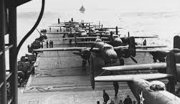
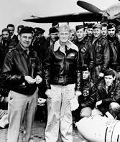
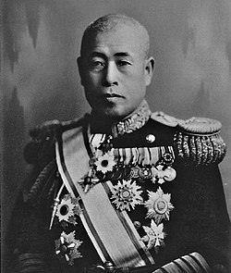
Japanese Attack on Pearl Harbor
Emperor Yamamoto’s famous quote- “I fear all we have done is to awaken a sleeping giant and fill him with a terrible resolve.”
U.S. retaliates with the Doolittle Raid-18 April 1942), a surprise attack on Tokyo, Japan, by U.S. bombers during World War II. Little damage resulted, but the raid was a boost to American morale at a low point in the war.

Slide 9
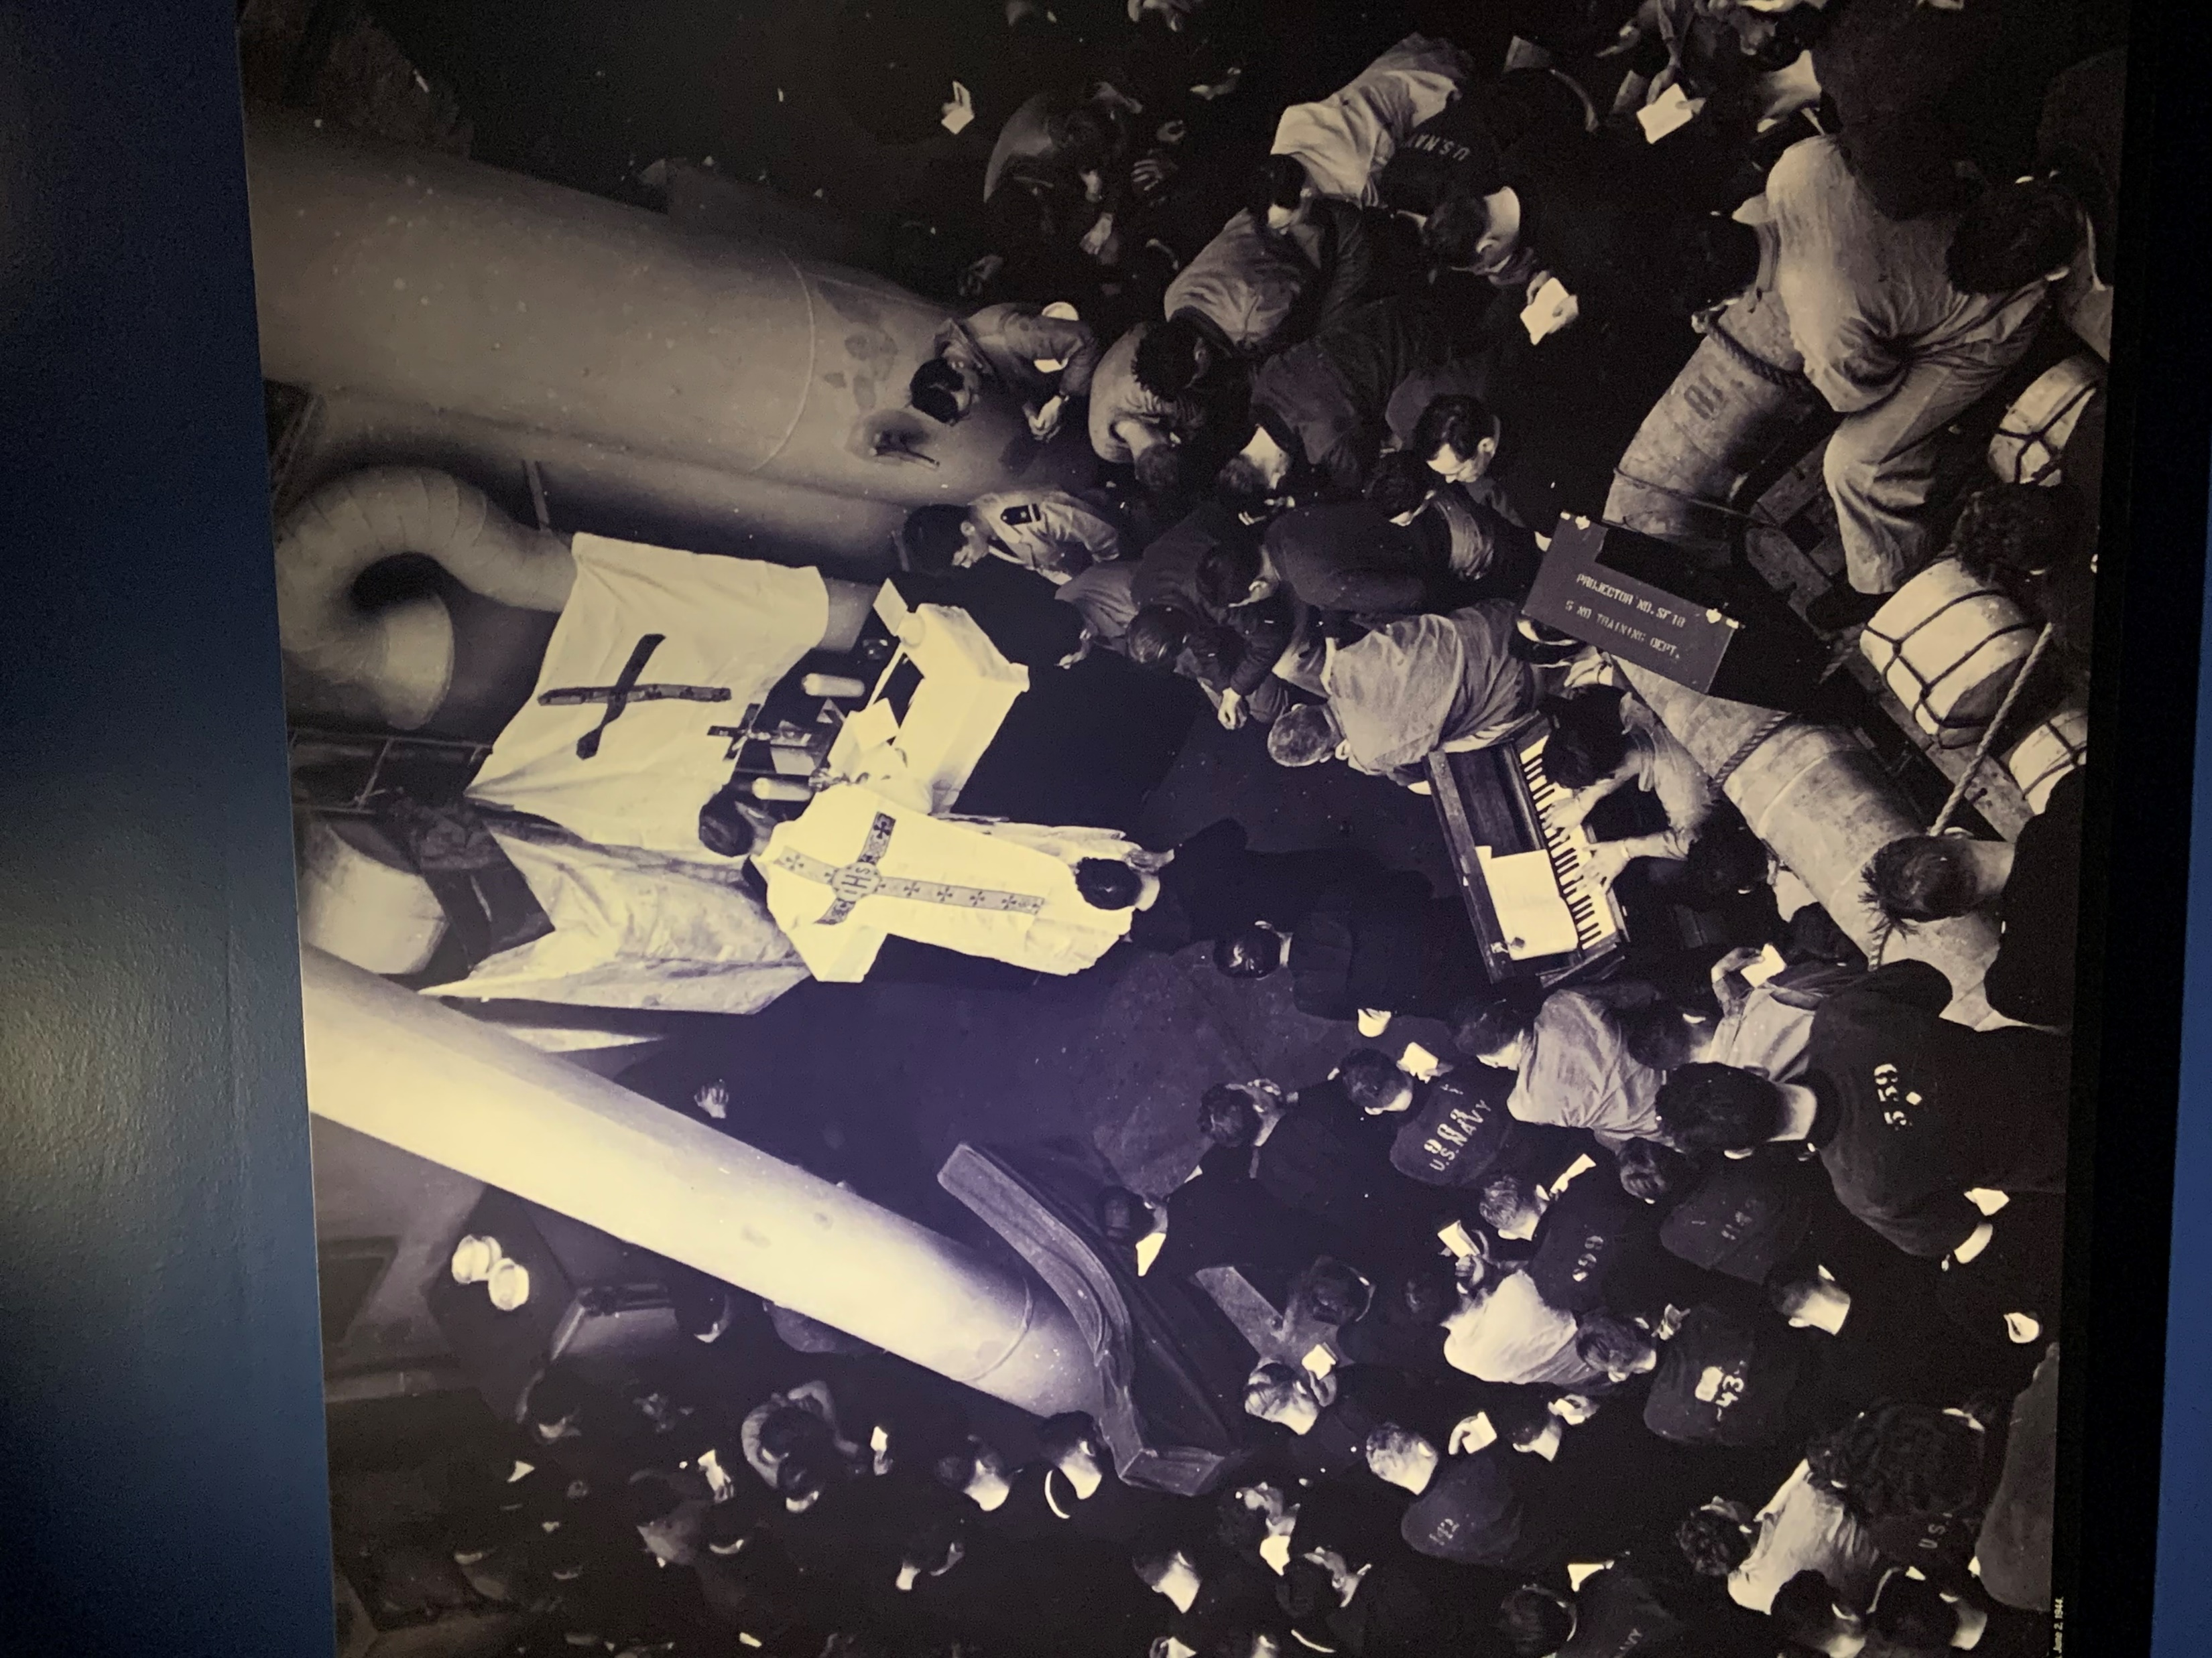
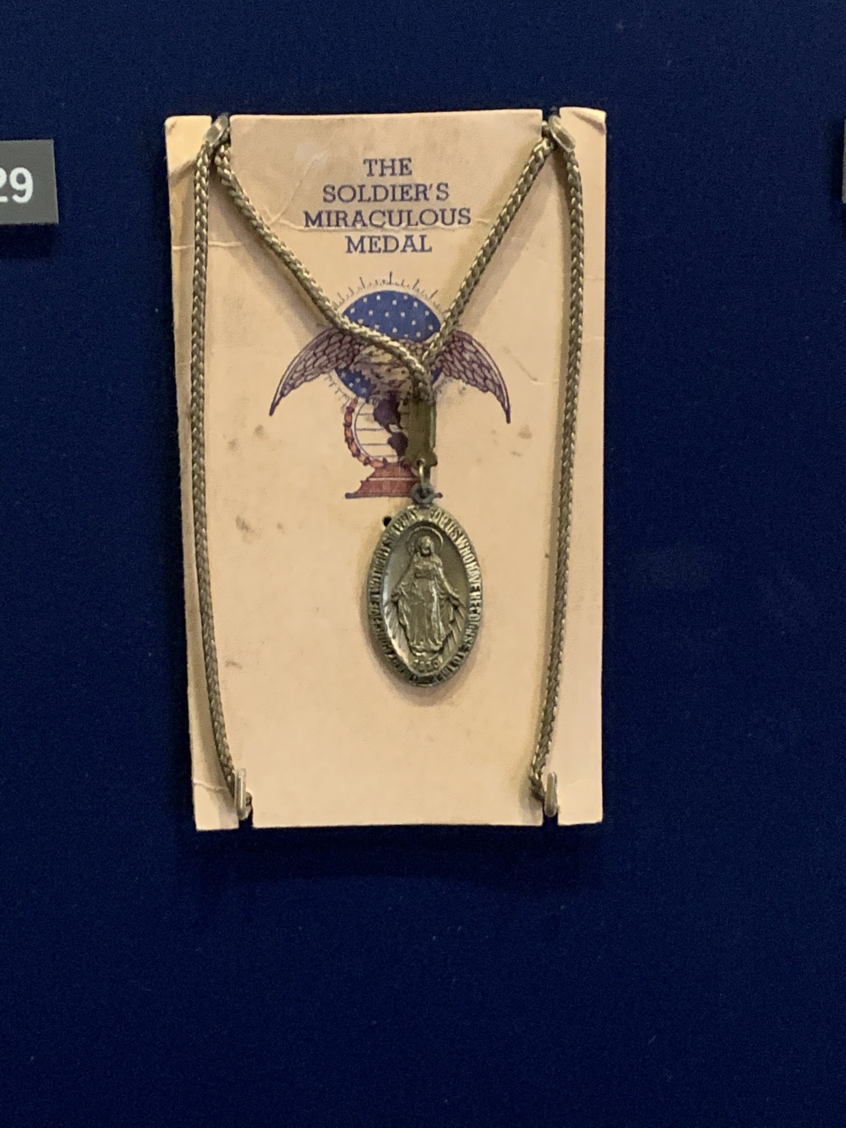
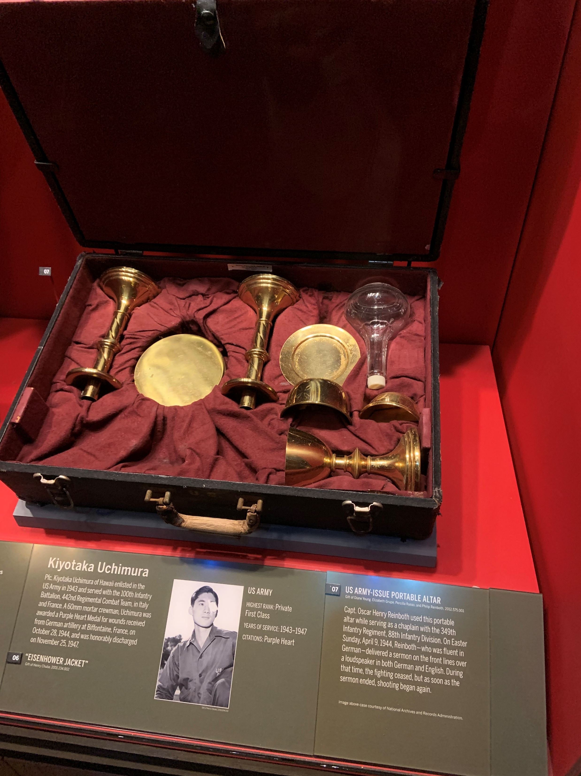
Catholic Identity in the Midst of World war II
Latin Mass held on board a battleship. (Before Vatican II)
A soldier’s Miraculous Medal
A portable altar used to celebrate Mass.

Slide 10
Coming up next:
Thursday: Assemble Allied and Axis Leaders assignment in History notebook.
Finished Early? Answer the following questions in your History notebook on the page AFTER your Allied and Axis Powers assignment:
What types of leaders came to power in Italy, Germany, and the Soviet Union before World War II?
Which countries formed the Axis Powers and the Allied Powers?
How did the Lend-Lease Act help the Allies?
What event brought the United States into World War II?
Considering WWI and the Great Depression that the United States was just starting to recover from at the time WWII began, do you agree with the U.S. position of Isolationism at the beginning of WWII? Do you think the U.S. should have joined the war before the attack on Pearl Harbor? Explain.
Friday: Pearl Harbor survivor stories and class discussion.
Coming Up Next Wednesday: The European Theatre

Slide 11
Stories from Pearl Harbor
Original news broadcast on Pearl Harbor attack:
https://www.youtube.com/watch?v=A2kSnlS4xX8
Survivor Interviews:
https://www.youtube.com/watch?v=5LK2sRmffc0
https://www.youtube.com/watch?v=a8g98ZhAUZ8
https://www.youtube.com/watch?v=8BfKfDGRzbg
https://www.youtube.com/watch?v=8BfKfDGRzbg
What do these stories say about the American Spirit? What examples of patriotism do you see in these interviews? What is your definition of a hero? How do you think Americans felt after this attack? These men fought to protect the freedoms we have in this country today. What are some privileges you are thankful for having because you live in a free country?

