Slide 1
WWII: The European Theater

Slide 2
Let’s Review!
WWII Begins
Unresolved Tensions From WWI
Attack on Pearl Harbor
~Germany suffers many reparations due to terms in the Treaty of Versailles.
~Hitler and the Nazi Party rise to power in Germany.
~Fascist dictators want to expand.
~U.S. wants to stay out of foreign affairs.
~Hitler invades Poland and France and England declare war.
~Allies: France, England, U.S. (after attack on Pearl Harbor), Soviet Union, China
~Axis: Germany, Italy, Japan
~Prior to the attack, the U.S. adopted policy of Isolationism.
~U.S. sent supplies to Allies via Lend/Lease Act.
~Jaoan attacks U.S. at Pearl Harbor on Dec. 7th , 1941.
~President Franklin D. Roosevelt asks Congress to declare war the next day.

Slide 3
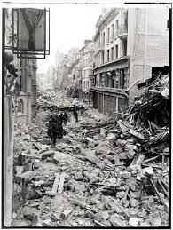
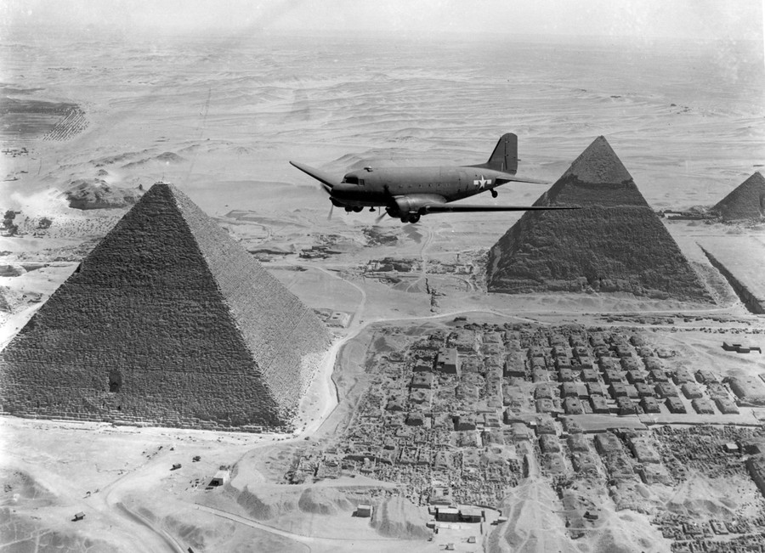
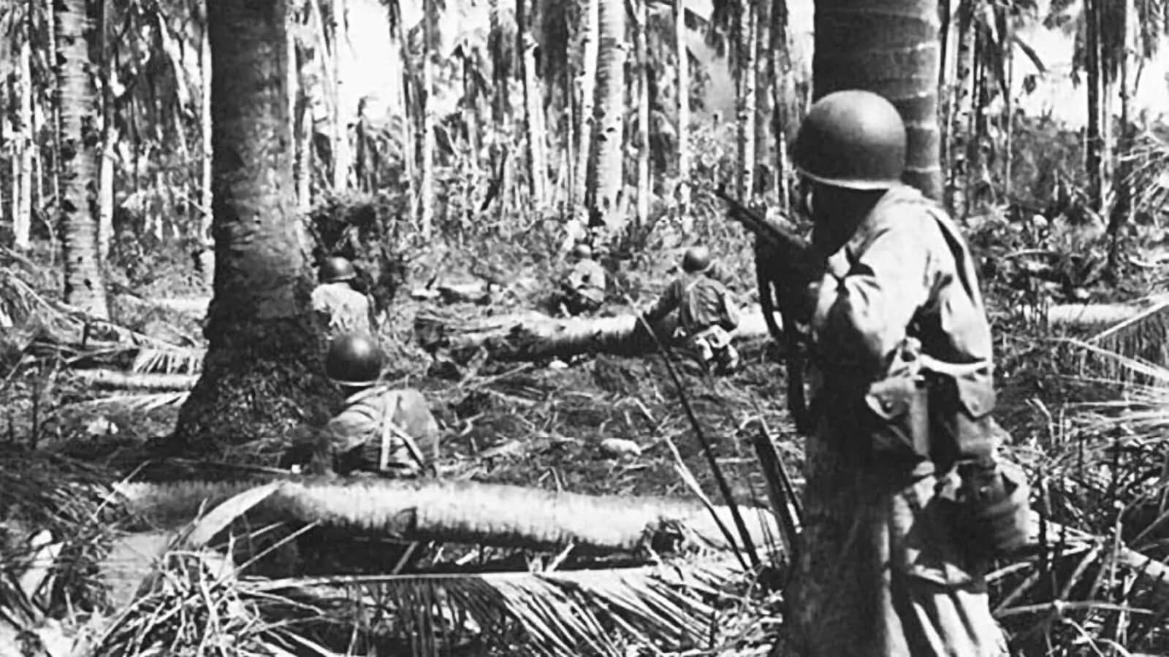
WWII IS FOUGHT ON 3 MAIN FRONTS
European Theater
North African Theater
Pacific Theater
Next Monday
Next Monday

Slide 4
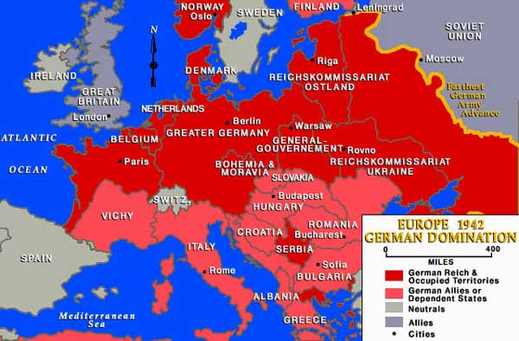
THE EUROPEAN FRONT
~In the first few years of WWII, Germany had a powerful military that advanced quickly throughout Europe.

Slide 5
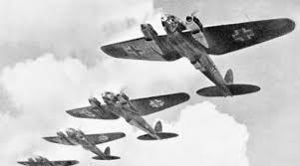
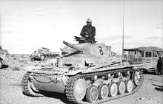
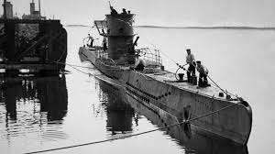
What Made Germany So Effective in Taking Over Surrounding Countries?
German U-boats- (undersea boat)- traveled undetected through the water to sink ships
Luftwaffe- German Air Force (bombers)
Panzer Tanks- well armed and good mobility
Blitzkrieg (Lightening War) Strategy- Used tanks, planes and artillery to drive a breach in enemy defenses.
This allowed tank units to come in quickly and roam freely behind enemy lines.
This caused chaos, shock, and disorganization among enemy defense.
https://www.youtube.com/watch?v=H4krV180eRQ (2:19)

Slide 6
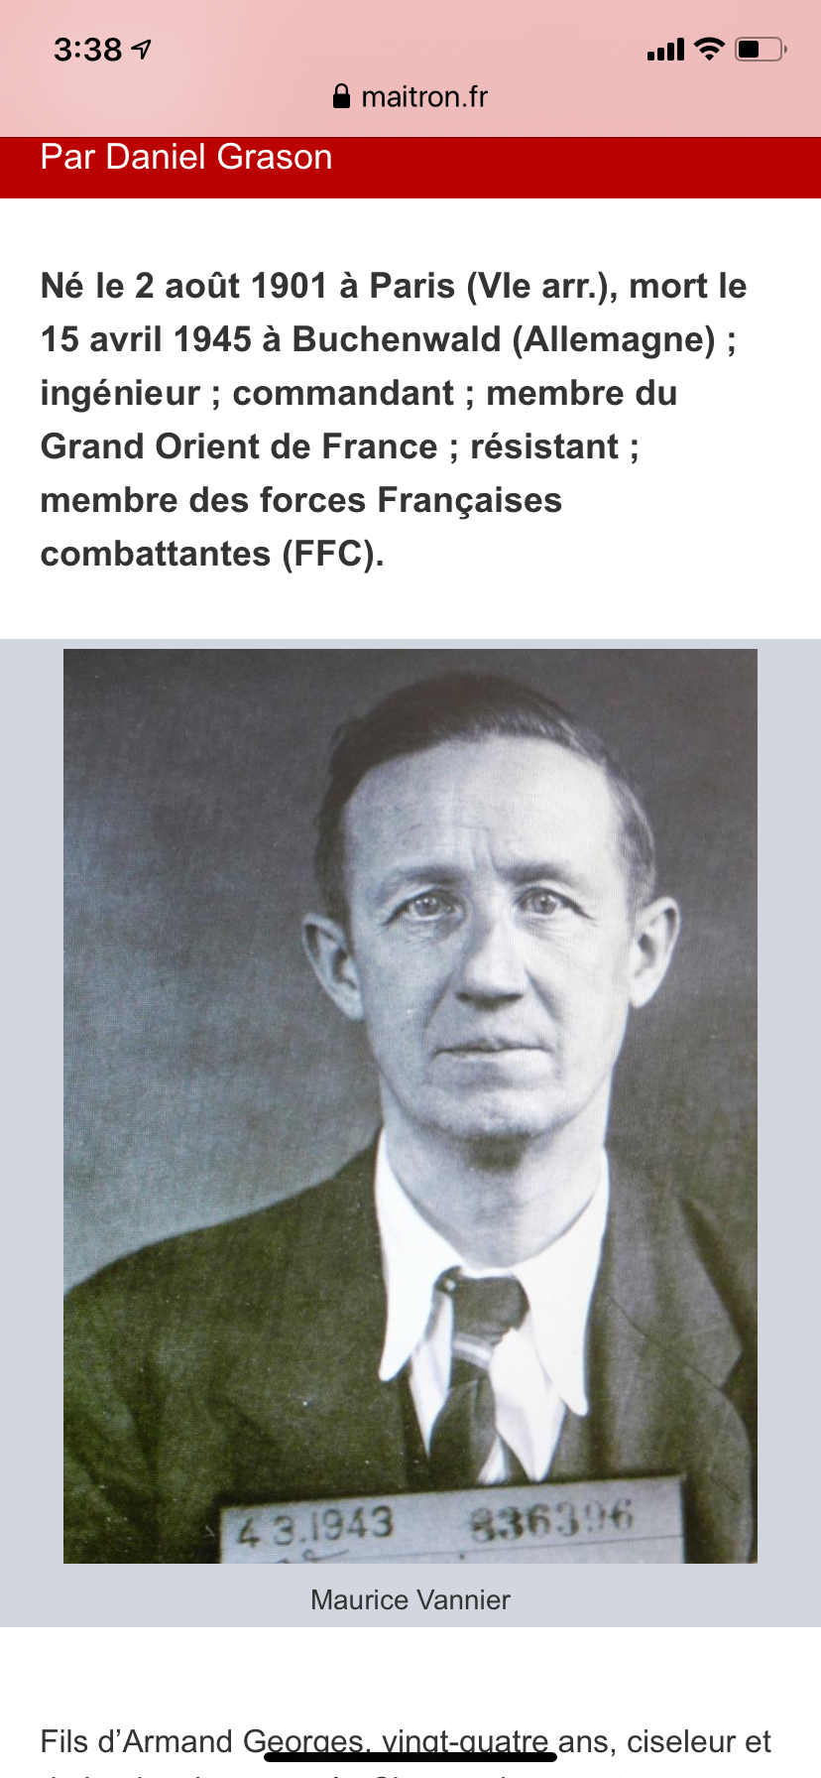
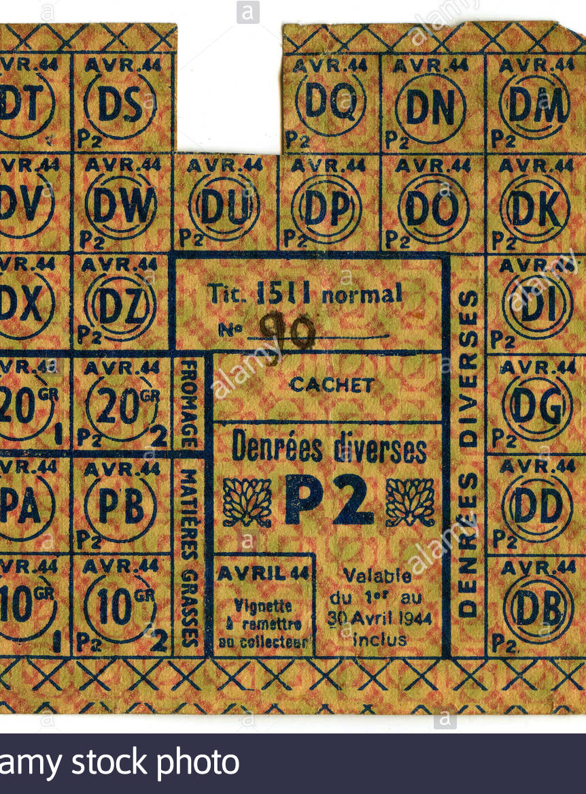
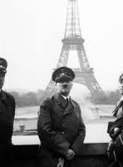
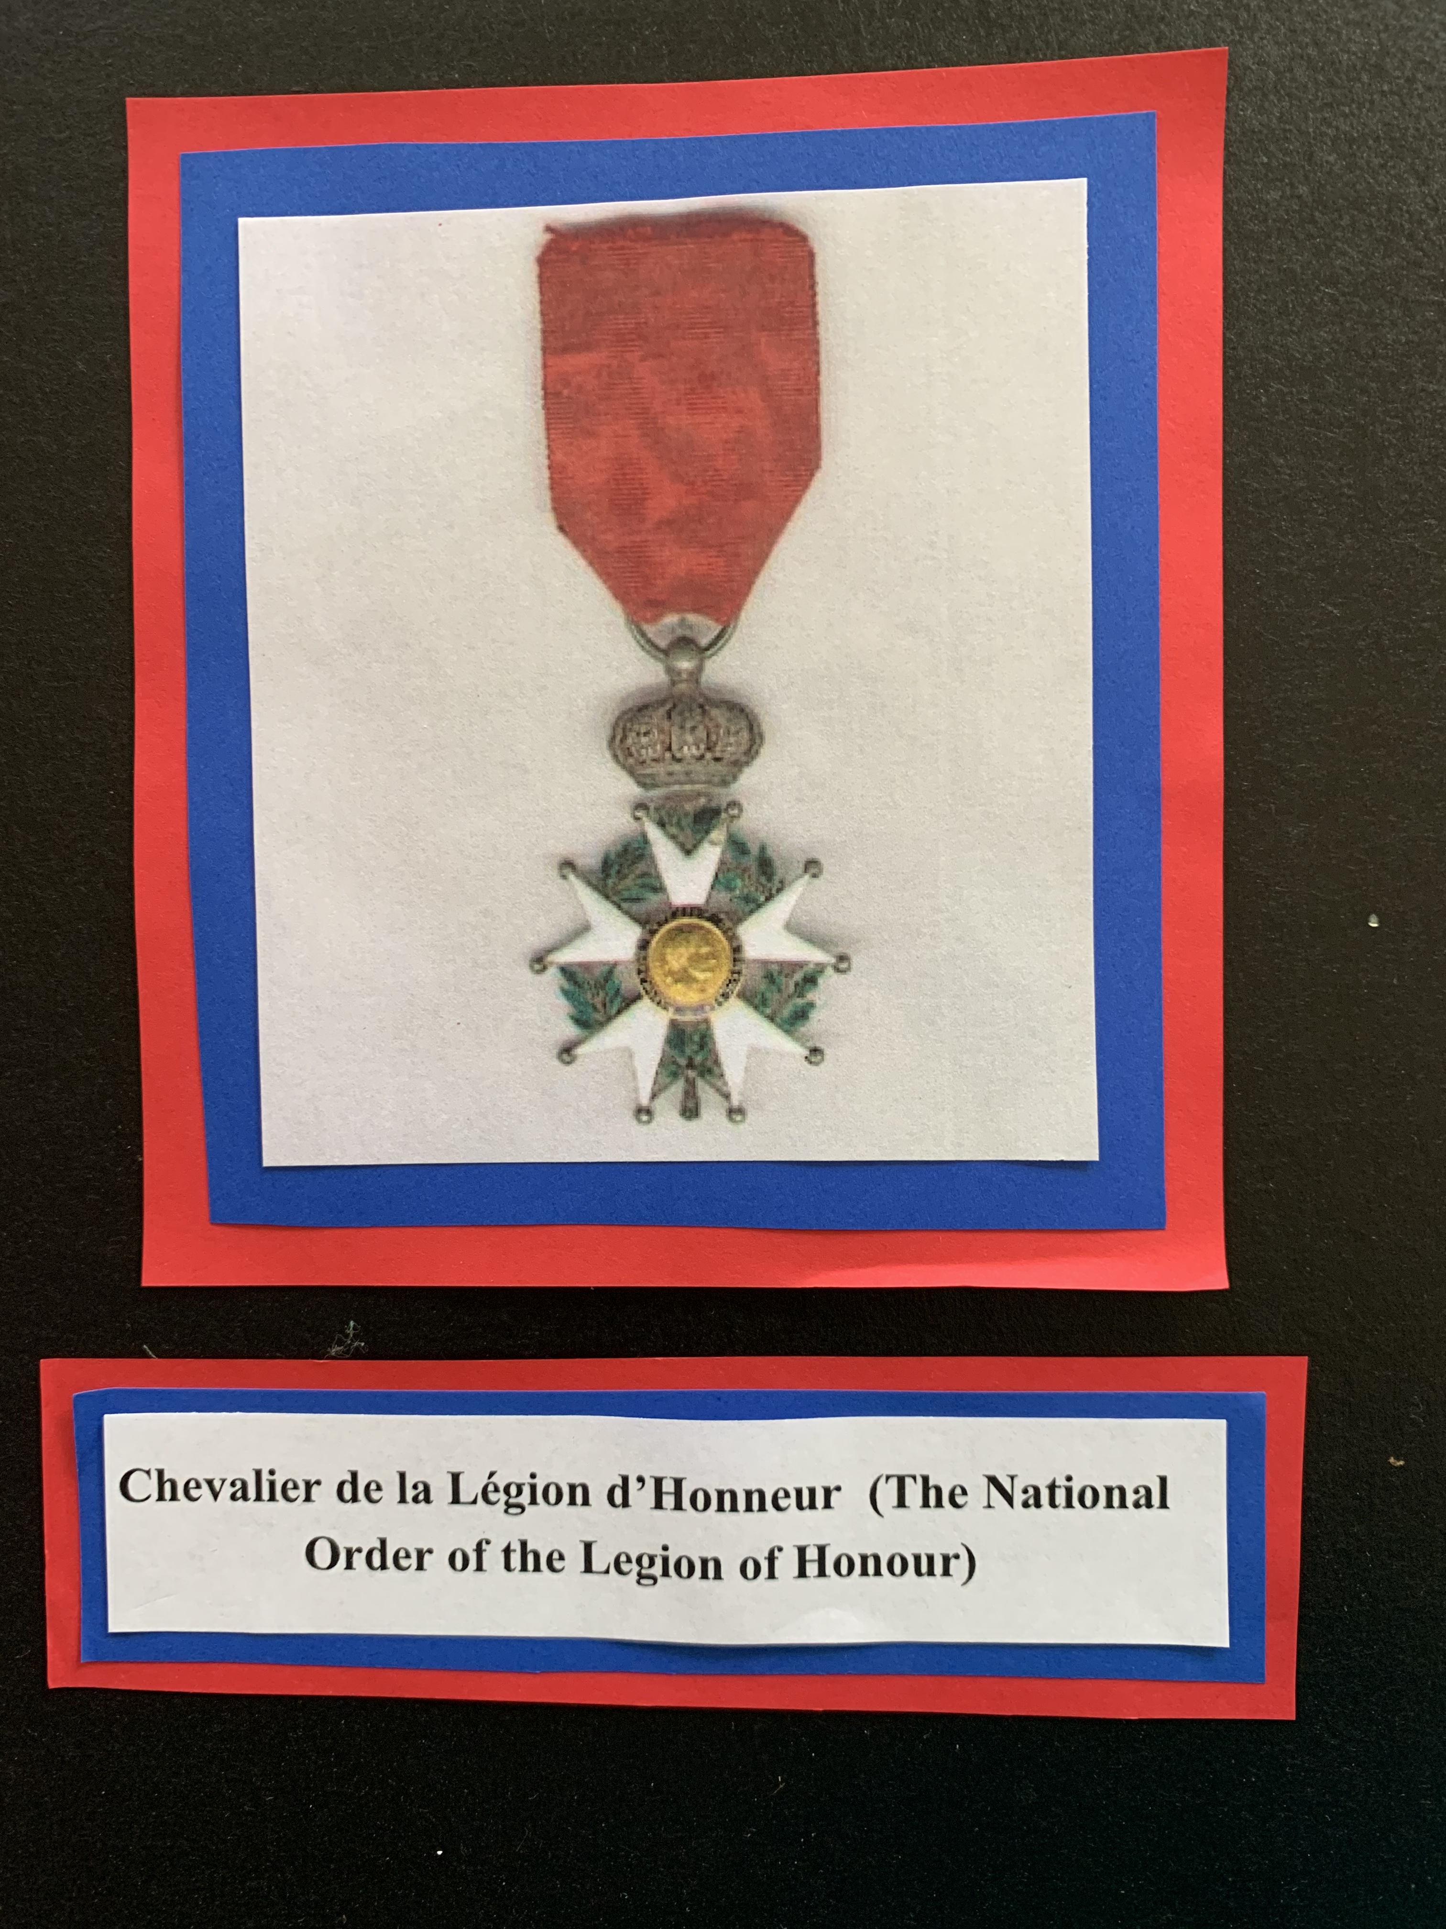
Life in German Occupied Europe
Germany gained control of France in 1940.
Gra-mere’s Story
She was your age growing up in France.
Instead of a backpack, she carried a gas mask to school.
Nazi soldiers lined the streets where she walked. She saw people beaten and shot.
Her mother was in charge of rationing for her town.
Her father was part of the French resistance, (Charles de Gaulle)He made sure U.S & British spies were safe when they came into France. His code names was “Wicker.” He was turned in by a French citizen.
He went to Buchenwald for 15 months, survived, and died 3 days after liberation.
Count your blessings.
Everyone has their cross to bear.

Slide 7
Battle of Britain
~Britain stood alone against the German War Machine.
~Hitler prepared to invade Britain in 1940.
~He had to beat the British Royal Air Force first. He attacked British air fields and planes.
~Winston Churchill vowed “ We shall fight them on the beaches.” “We shall fight in the fields and in the streets, we shall never surrender.”
~British RAF has new radar technology that allowed them to locate Luftwaffe planes and destroy 2,300 of them.
~Hitler cancelled his invasion of Britain.
~Great example of the determination and fortitude of the Allies.
https://www.britannica.com/video/22972/air-ground-Battle-of-Britain-documentary-The-June-1940

Slide 8
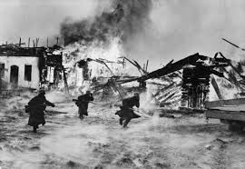
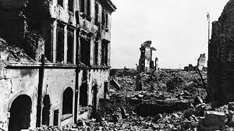
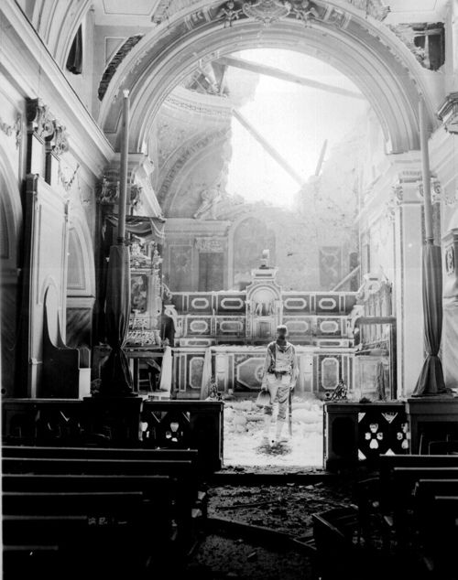
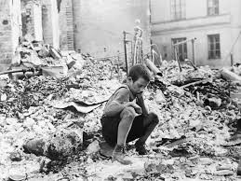
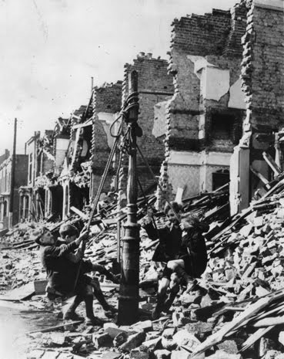
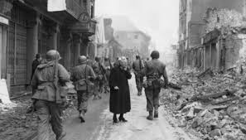
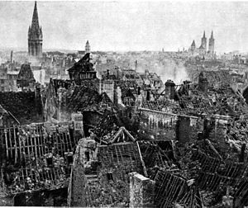
Europe is in Ruins
Norway
POLAND
France: Catholic Church
POLAND
London
DENMARK
FRANCE

Slide 9
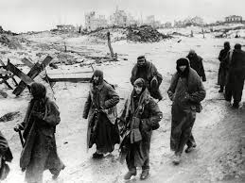
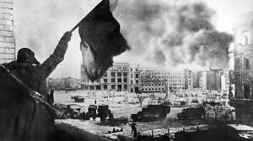
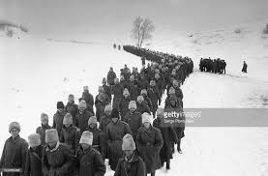
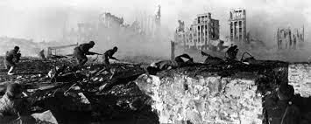
Turning Point in the War in Europe: The Battle of Stalingrad
Background History
Battle Events
Outcome
In 1939, Hitler and Stalin signed a non-aggression pact.
They agreed that neither country would invade the other and they would divide Poland between their two countries.
Hitler violated this and invaded the Soviet Union in 1941
Stalin joins the Allies.
German forces advanced to Stalingrad (modern day Volgograd).
Germans occupied the majority of the city, but Soviet troops kept fighting.
Germans began to run out of supplies, but Hitler told them to keep fighting. Most German soldiers froze or starved to death. They surrendered in 1943.
After a large-scale tank battle in Kursk, Axis powers retreated.
The tide of the War in Eastern Europe turns.
Bled the German military dry of resources.
German Army in full retreat.
https://oshs.roaneschools.com/apps/video/watch.jsp?v=194821

Slide 10
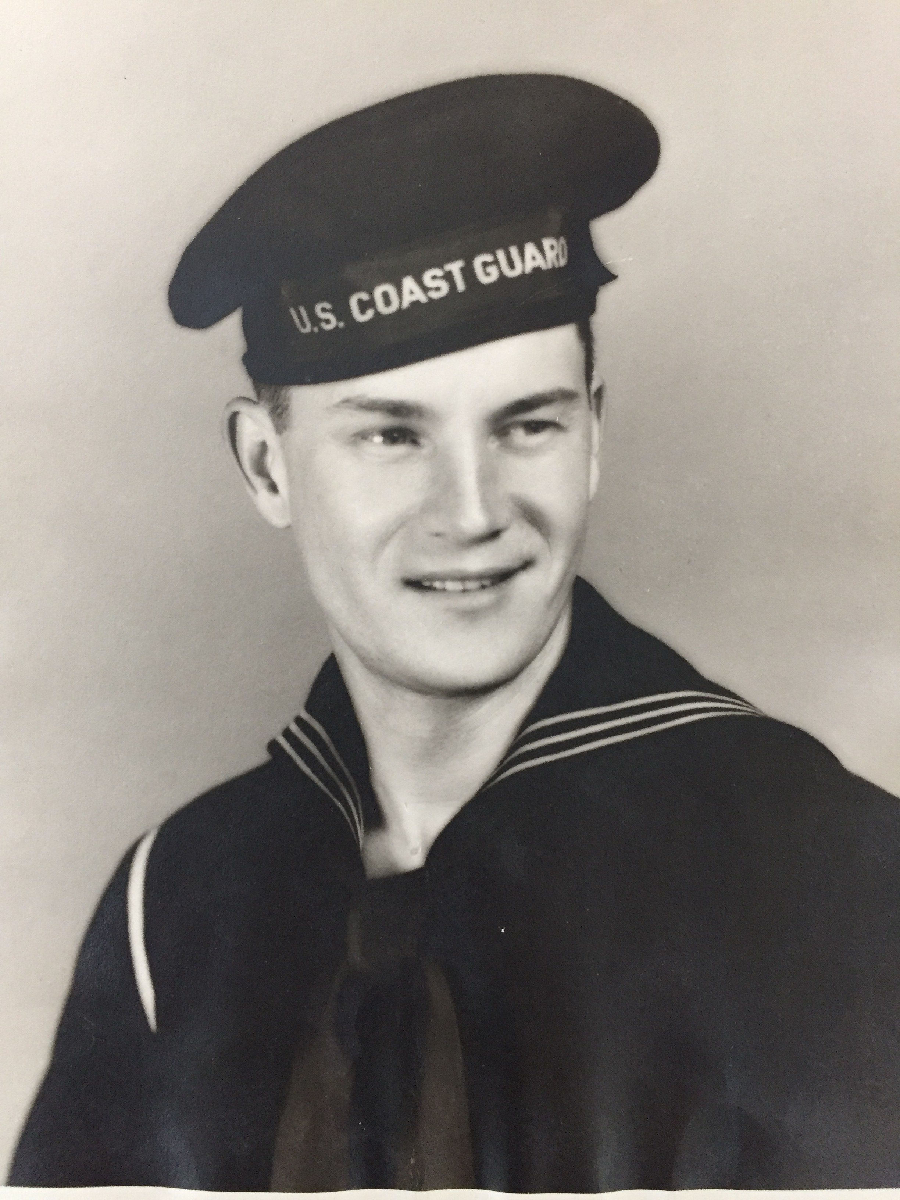
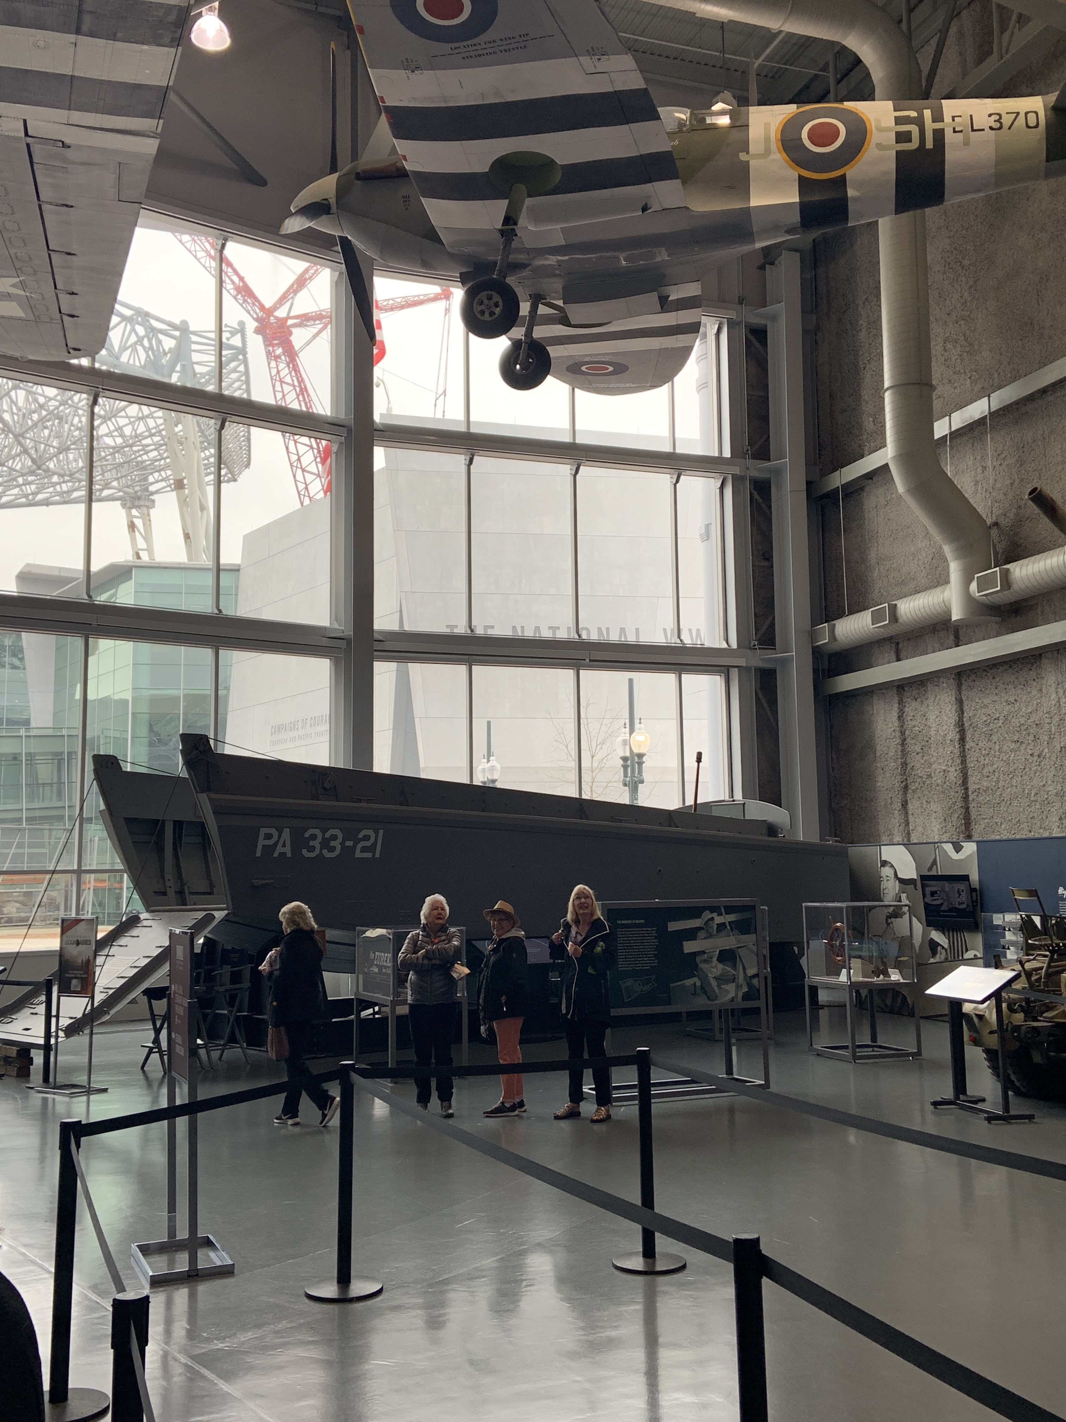
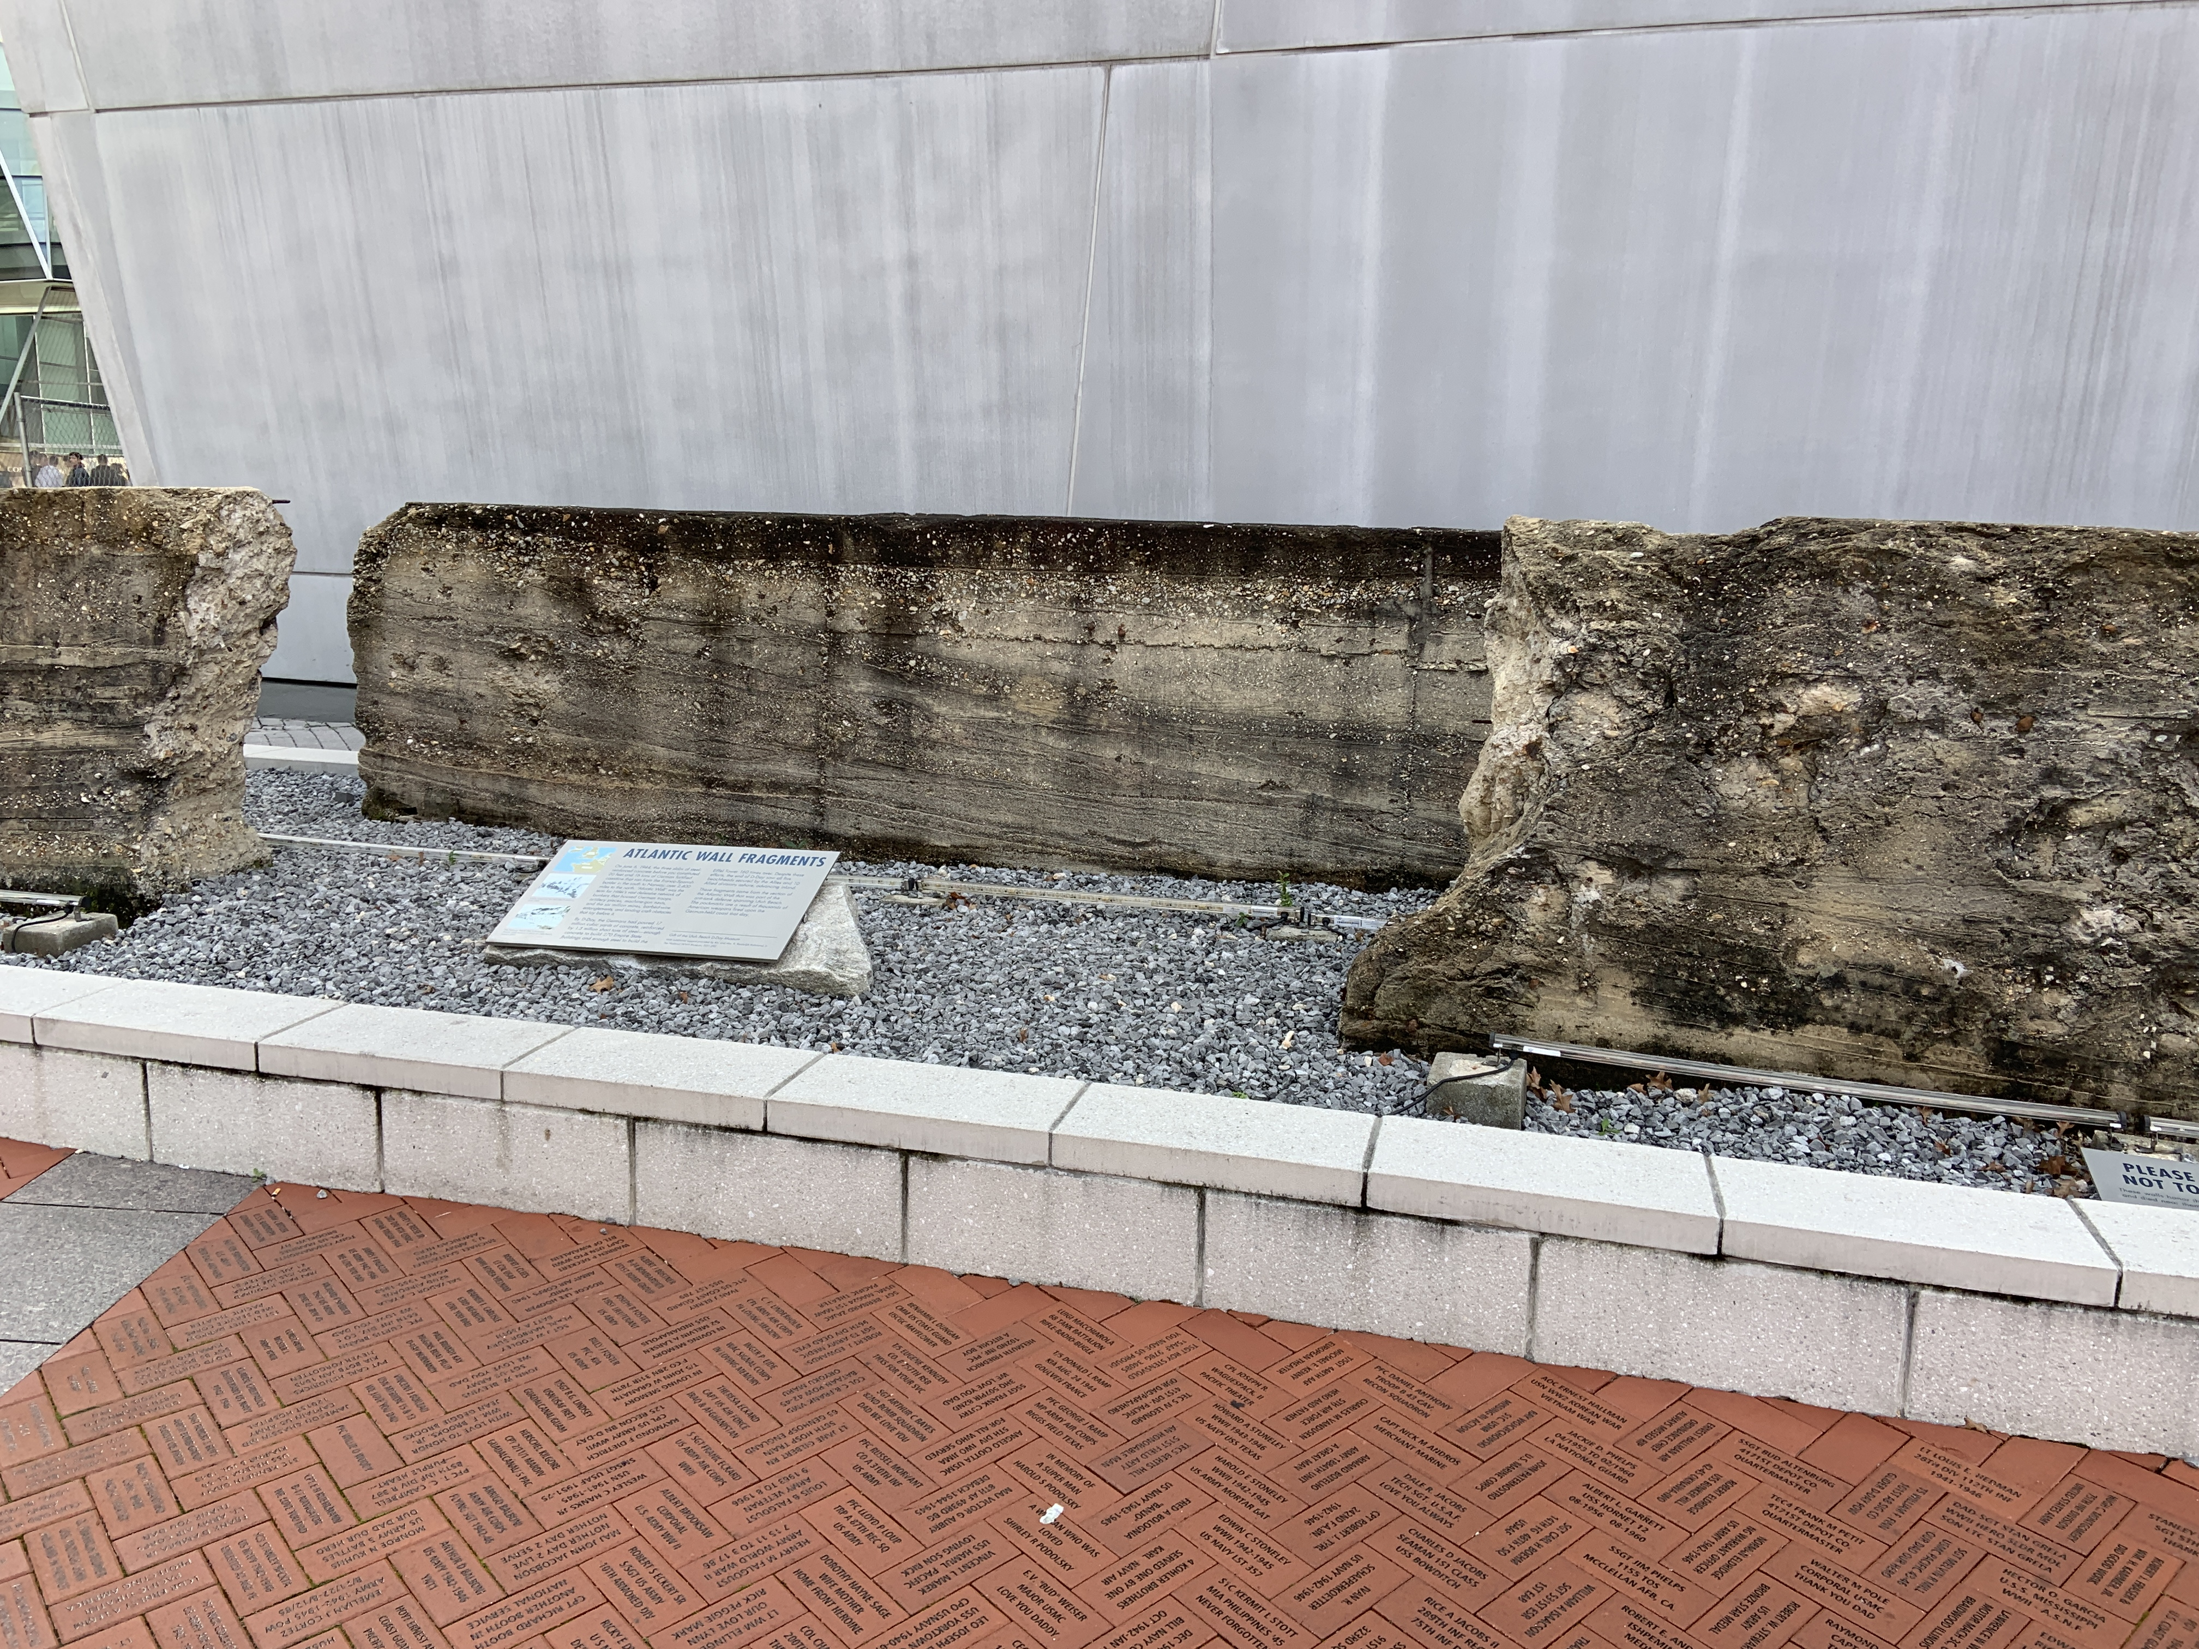
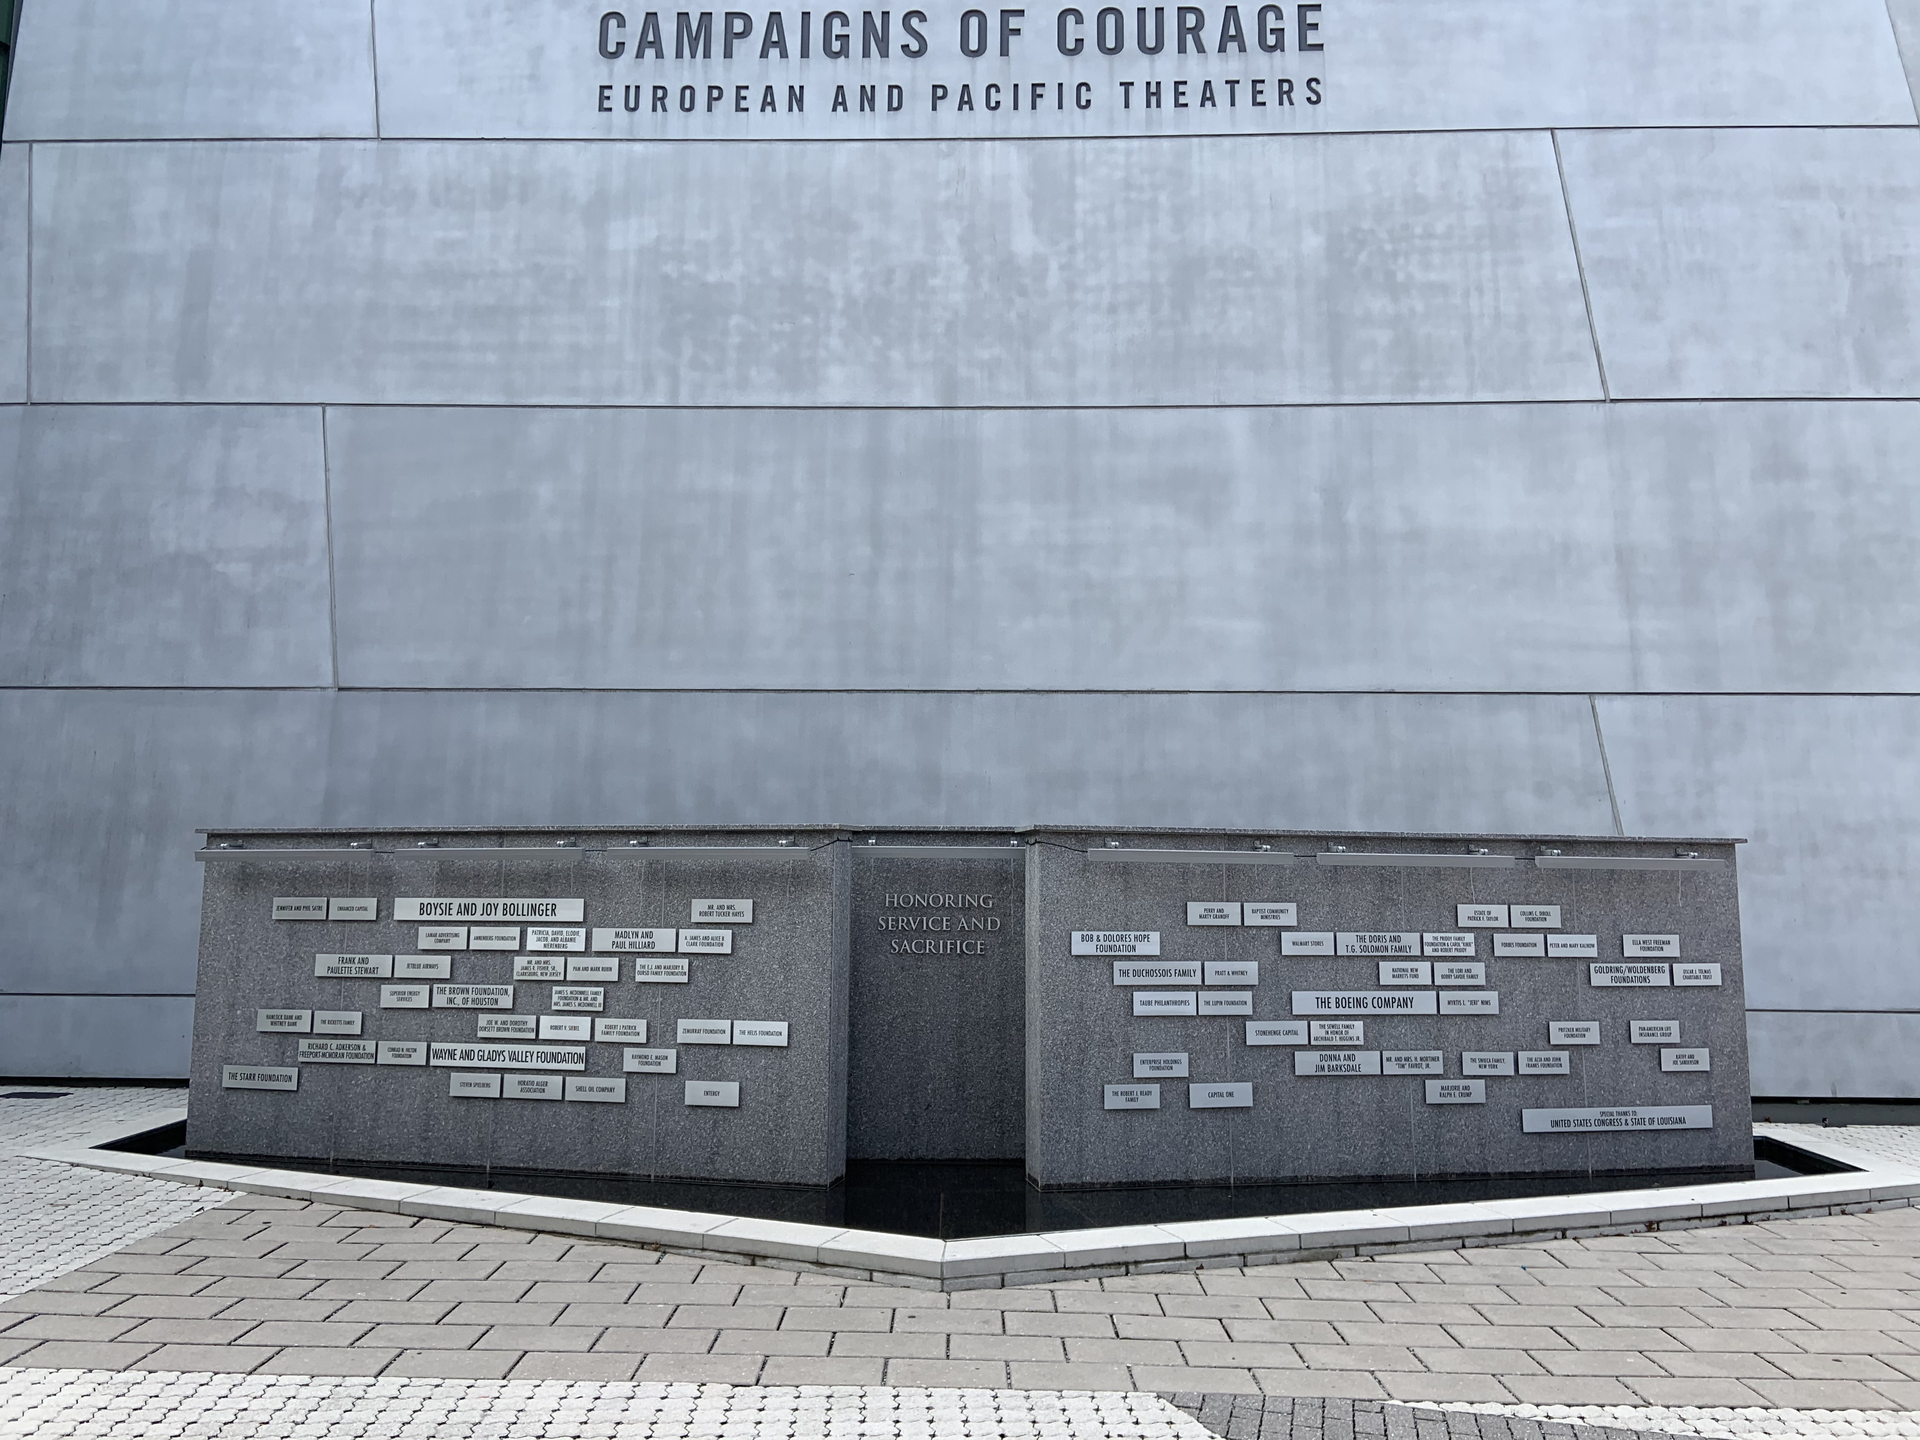
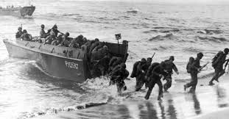
D:DAY: NORMANDY, FRANCE
~First steps toward liberating all of Europe from German control & forcing Hitler to surrender.
~ Largest land & sea battle ever attempted
~ Led by General Dwight D. Eisenhower (later becomes 34th U.S. President).
~Allied troops invaded France on June 6,
1944—known as D-Day, or “designated day.”
~More than 6,000 ships, 11,000 planes, and 156,000 men stormed the beaches of Normandy, France.
~First waves suffered largest casualties- men on foot.
~Higgins boats- Andrew Higgins
~By the end of D-Day, all beaches were secured. The Allies then began driving east through French villages and countryside toward Germany.
https://www.youtube.com/watch?v=RIIN0Ug8wg8

Slide 11
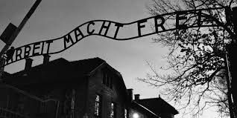
COMING UP TOMORROW:
The Holocaust

Slide 12
On Wednesday:
Hear about the story of A soldier who fought in Normandy during D-Day and the priceless artifact that he brought back home From the beaches.

Slide 13
Next Week:
Monday: The WAR IN THE PACIFIC AND NORTH AFRICA
Tuesday: The Home front
Wednesday: The War Ends

