Slide 1
The Pacific and North African Theaters
WWII:

Slide 2
-WWII fought on 3 fronts: Europe, North Africa, and the Pacific -War in Europe was made the 1st priority by the Allied leaders. - The Battle of Stalingrad and D-Day advance start to give Allied forced the advantage in Europe.
Let’s Review!

Slide 3
Let’s Review!
December 7th, 1941
Japan attacks the U.S. at
Pearl Harbor, Hawaii.
December 8th, 1941
President FDR asks Congress to declare war on Japan.
1941
The attack left the U.S. Pacific fleet severely wounded, so there was no immediate U.S. retaliation, and Japan advanced.

Slide 4
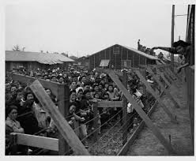
Internment Camps
After Pearl Harbor, U.S. citizens feared Japanese Americans.
They believed they were spies and had unsubstantiated suspicions.
President FDR issued Executive Order 9066, which began the process of internment.
About 115,000 Japanese Americans were evacuated from their homes and held in internment camps. Some Americans of German and Italian ancestry were also held in internment camps during the war.
https://www.youtube.com/watch?v=cZTioTkHcB0

Slide 5
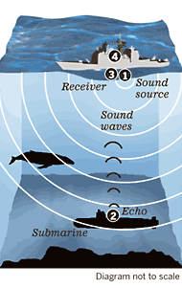
Attack on German Forces in North Africa
In addition to key battles in Europe, Allied forces wanted to attack the German forces in North Africa.
Major obstacle- German U-boats
Allies used new technology of sonar. This helped them find and destroy U-boats in the water.
Allied planes used sonar to drop bombs on important German targets- factories, railroads, etc.

Slide 6
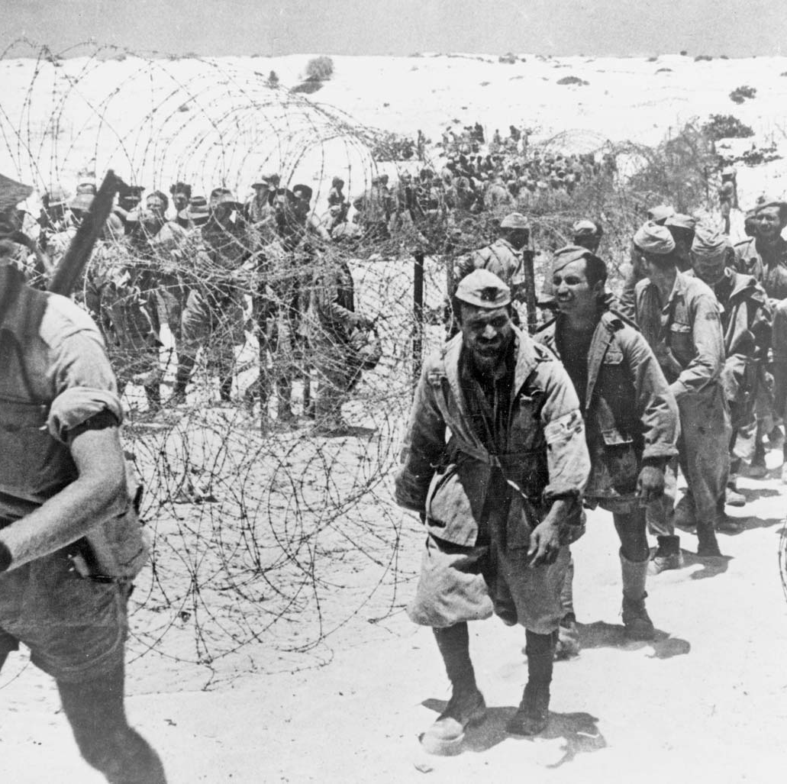
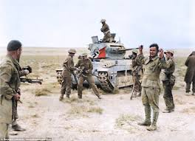
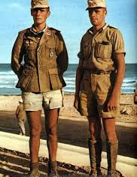
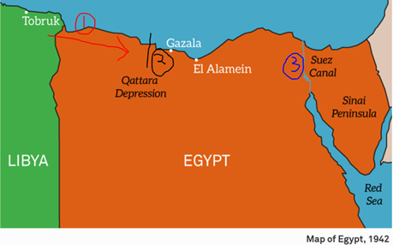
The Suez Canal, a crucial supply route in Egypt was a main objective.
British & U.S. Forces battled the German Afrika Korps for control of Egypt in the Battle of El Alamein.
Led by U.S. General Dwight D. Eisenhower and British General Bernard Montgomery

Slide 7
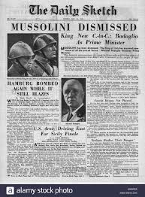
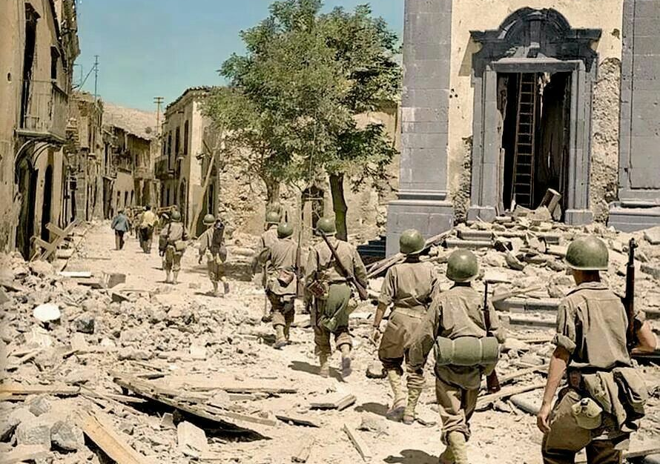
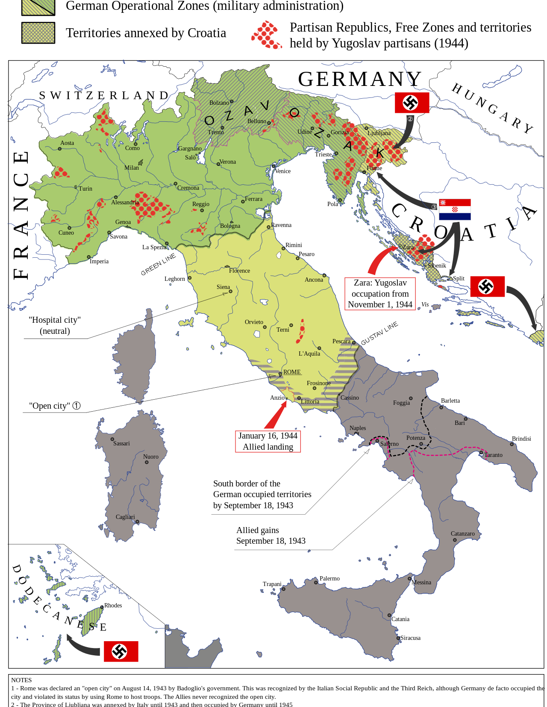
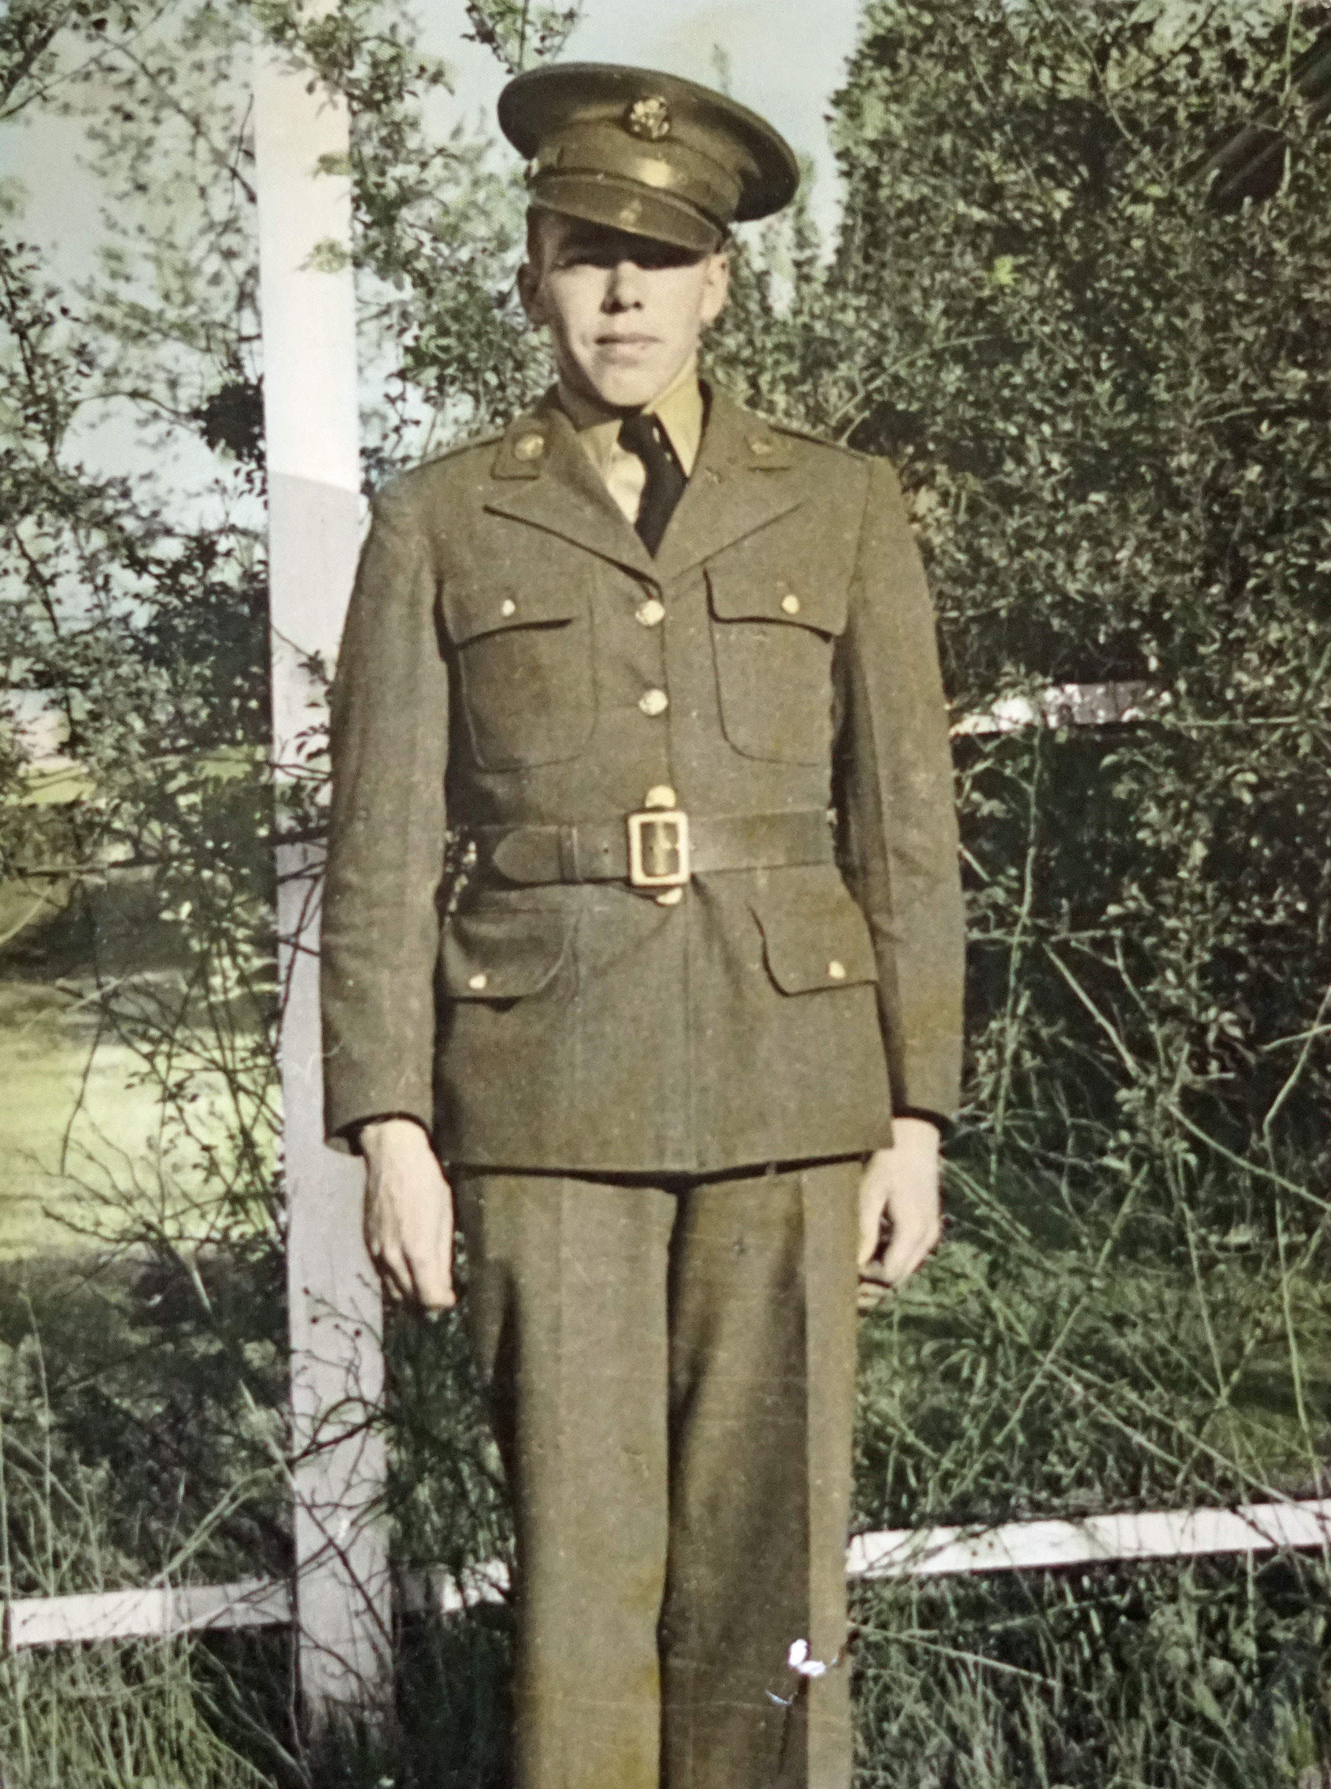
Next step- attack “soft underbelly” of the Axis (Sicily) and move in to the Italian mainland.
Italian leaders overthrew Mussolini and surrendered to the Allies.
Hitler refused to accept defeat- sent German troops to block the Allied advance.
Allied forces captured Rome in June 1944.
Early in 1945, German forces were driven out of Italy. Italian freedom fighters executed Mussolini.

Slide 8
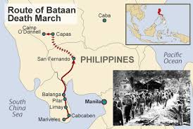
Japanese Advances
In addition to Pearl Harbor, Japan attacked American-controlled Phillippines.
American and Filipino forces under Douglas MacArthur could not stop the advance.
In March of 1942, American and Filipino troops surrendered to the Japanese.
Bataan Death March
https://www.youtube.com/watch?v=lHa66e8YhLw

Slide 9
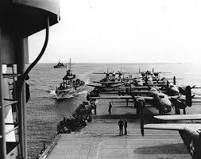
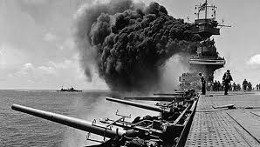
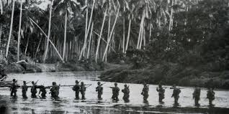
Key Battles in the Pacific
Battle of the Coral Sea
Battle of Midway
Guadalcanal Offensive
Led By- Admiral Chester Nimitz
Summary- This four-day battle marked the first air-sea battle in history. The Japanese sought to control the Coral Sea with an invasion of Port Moresby in southeast New Guinea, but their plans were intercepted by Allied forces. When the Japanese landed in the area, they came under attack by American task force.
Result- Both sides suffered damages to their carriers, but the battle left the Japanese without enough planes to attack Port Moresby, which led to an Allied victory.
Led By- Admiral Chester Nimitz
Summary- Japan planned to sneak up on U.S. ships in the Pacific, but Japanese codes were intercepted. U.S. surprised Japanese with a sneak attack and sunk 4 of their ships in addition to planes and over 3,000 soldiers.
Result- Turning point in Pacific, 1st major Allied victory in Pacific
Summary- U.S Marines launched a surprise attack against the Japanese to take control of a crucial airfield.
Fighting lasted 6 months
Soldiers in the jungles died from disease and lack of supplies just as much as from the bullet and bombs.

Slide 10
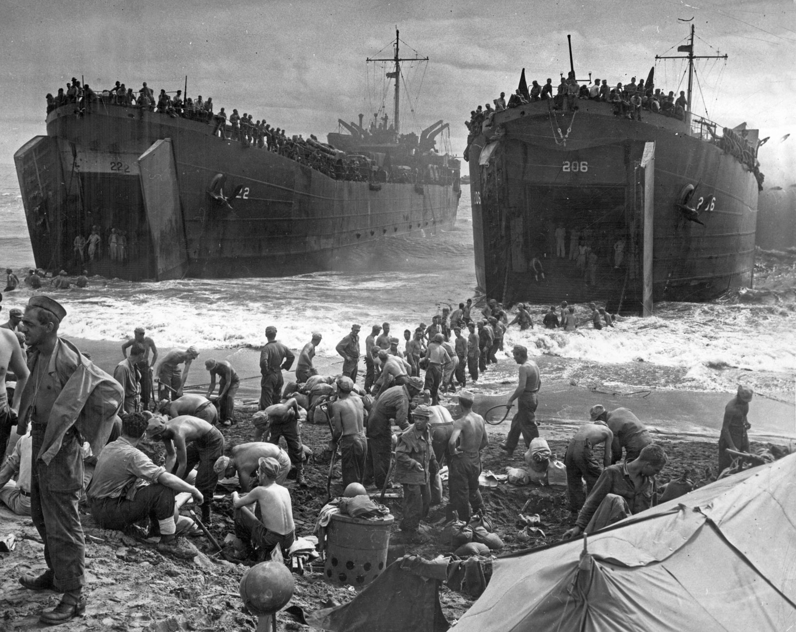
Key Battles in the Pacific
Battle of Leyte Gulf
Iwo Jima
Led by- General Douglas MacArthur
Summary- The mission was to retake the Philippines. It also gave the Allies a base from which to attack the main shipping routes that supplied Japan.
Result- The Allies crippled the Japanese naval fleet and recaptured the Philippines.
General MacArthur-“People of the Philippines: I have returned.”

Slide 11
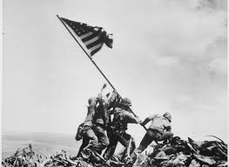
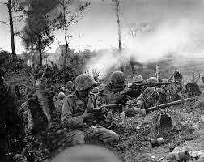
Key Battles in the Pacific
Battle of Iwo Jima
Battle of Okinawa
Battle of Leyte Gulf
Led by- General Douglas MacArthur
Summary- The mission was to retake the Philippines. It also gave the Allies a base from which to attack the main shipping routes that supplied Japan.
Result- The Allies crippled the Japanese naval fleet and recaptured the Philippines.
General MacArthur-“People of the Philippines: I have returned.”
Summary- The island of Iwo Jima had three airfields that could be useful in a potential invasion of mainland Japan. American forces invaded the island and the battle lasted for five weeks.
Result- In some of the bloodiest fighting of World War II, it’s believed that all but 200 or so of the 21,000 Japanese forces on the island were killed, as were almost 7,000 Marines.
https://www.youtube.com/watch?v=UTYUwt5rV5s
It was the largest amphibious landing in the Pacific theater.
Summary- The Battle of Okinawa was the last major battle of World War II, and one of the bloodiest. On April 1, 1945—Easter Sunday—the Navy’s Fifth Fleet and more than 180,000 U.S. Army and U.S. Marine Corps troops descended on Okinawa for a final push towards Japan. (Hacksaw Ridge)
Most Japanese troops and Okinawa citizens believed Americans took no prisoners and they’d be killed on the spot if captured. As a result, countless took their own lives. (Kamikaze pilots)
Summary- U.S. was within striking distance of mainland Japan.

Slide 12
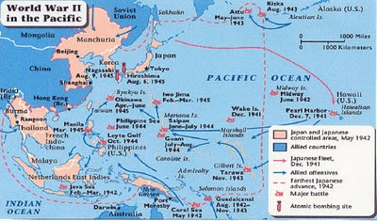
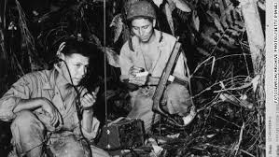
U.S. Strategies in the Pacific
Navajo Code Talkers
Island Hopping Strategy
About 400 Navajo Native Americans served as “code talkers,” relaying coded messages based on the complex Navajo language. Japan’s expert code breakers were never able to crack the Navajo code.
Navajo was chosen as a code language for World War II because in 1939 only about 30 non-Navajo people in the world could speak it.
https://www.youtube.com/watch?v=ciFv_ONffdw
Target islands with weaker defenses and set airfields supplies there.
Japanese occupied islands are stranded where they are.
https://www.youtube.com/watch?v=TBgxW3H_tsI

Slide 13
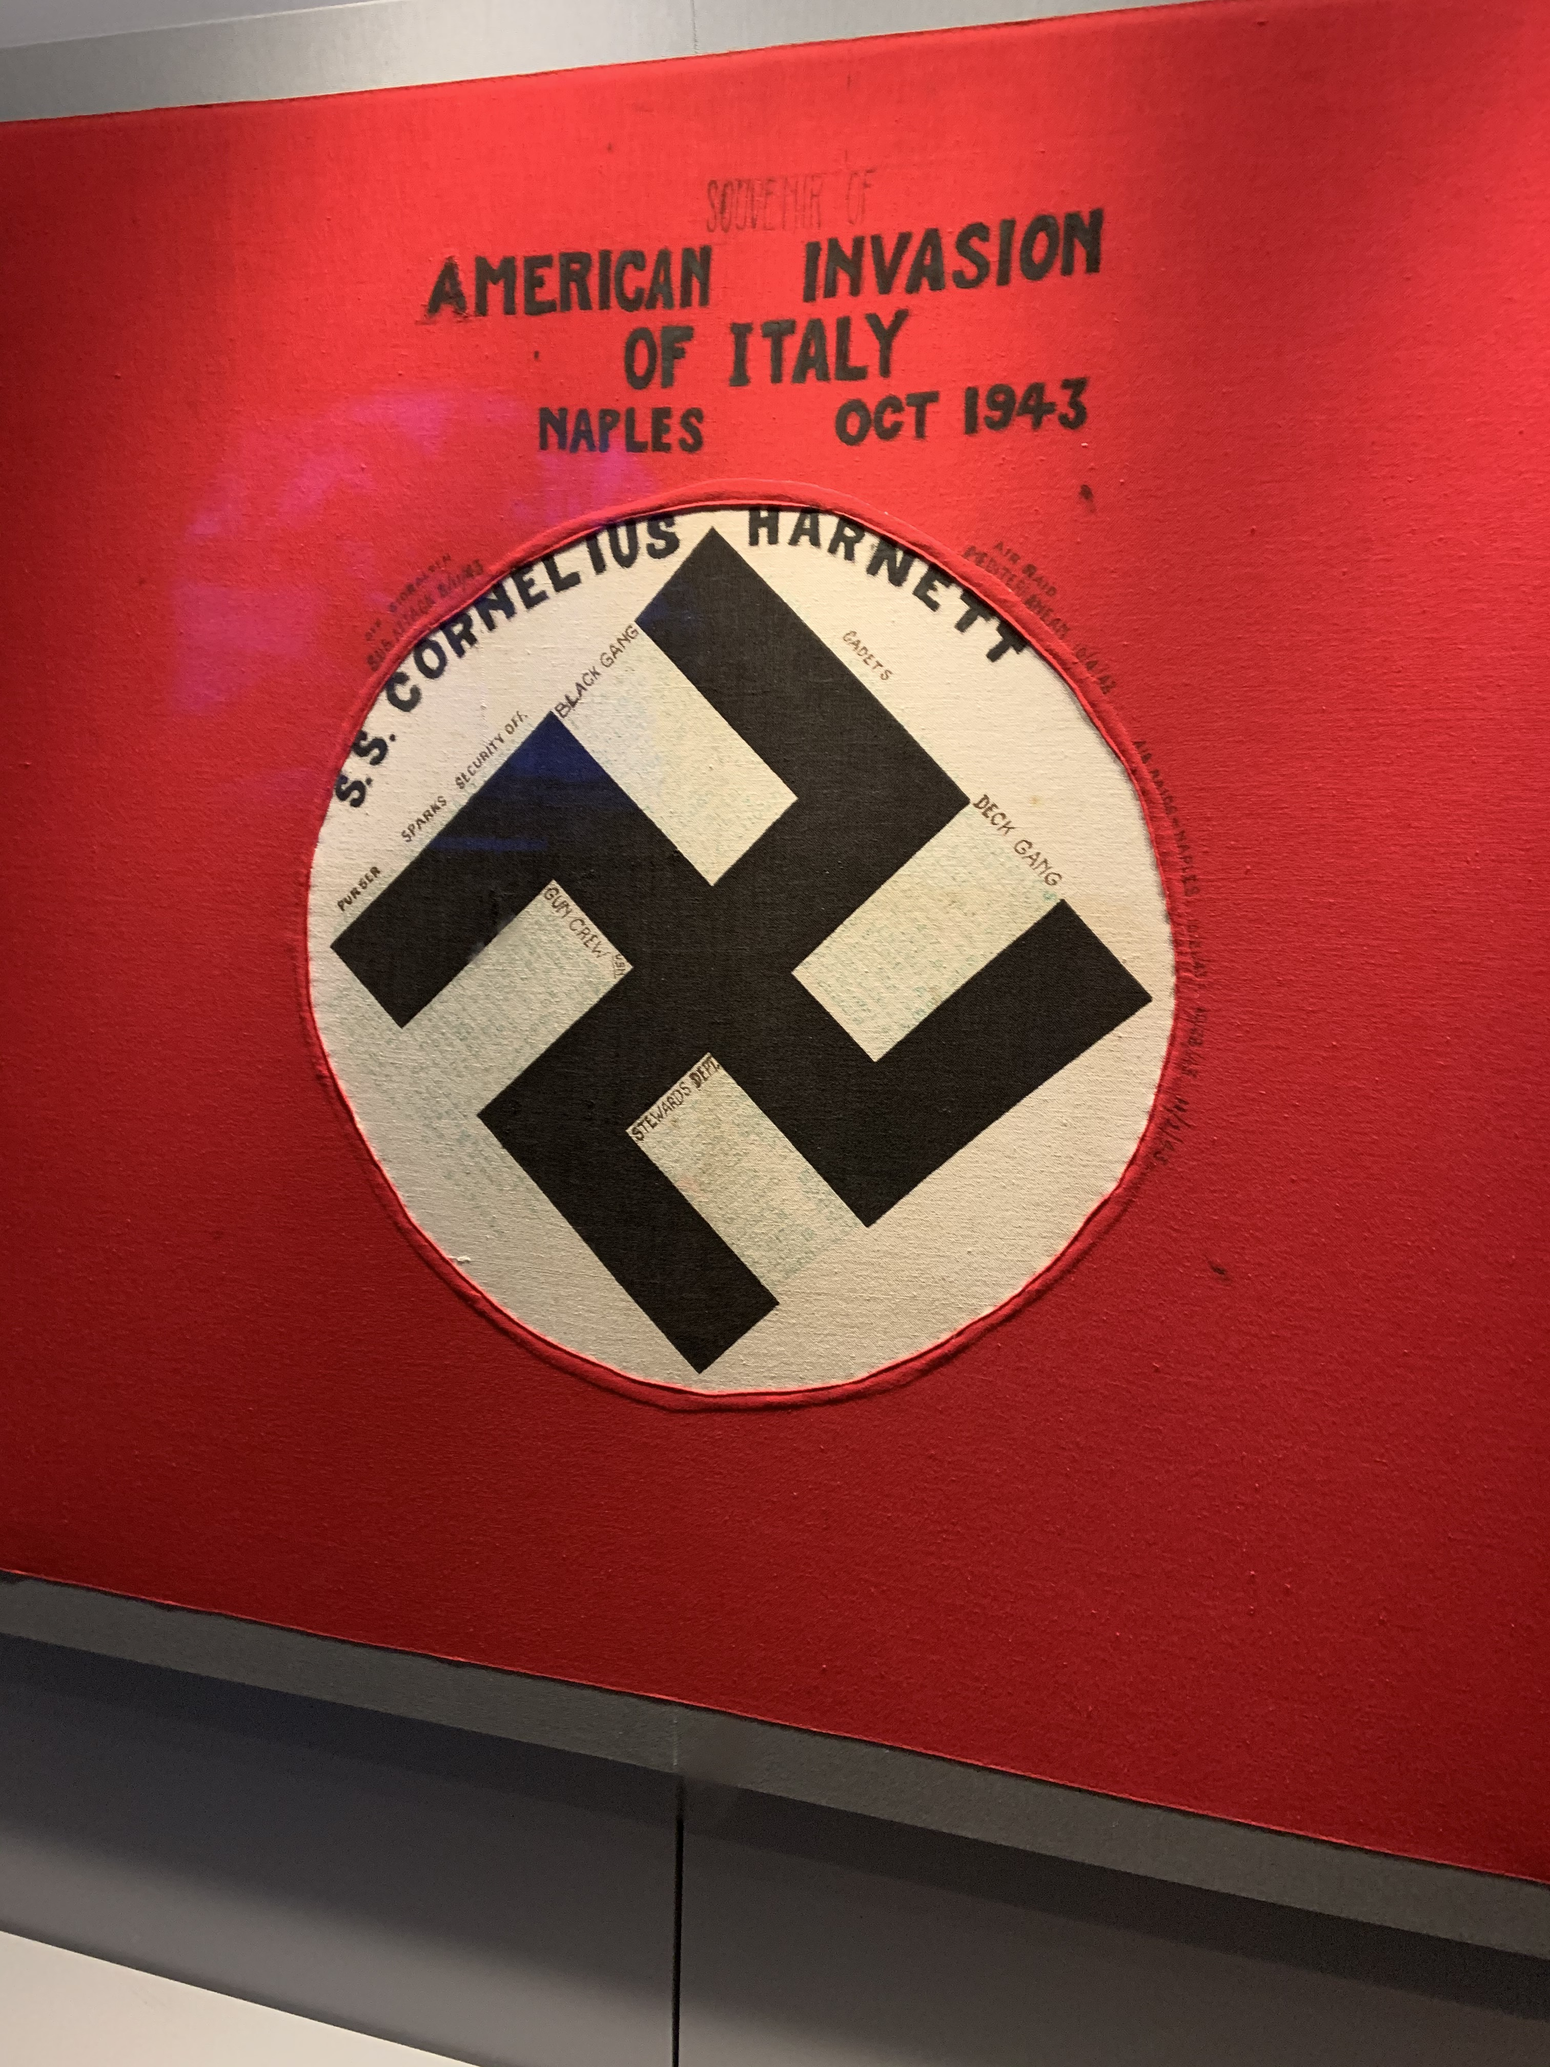
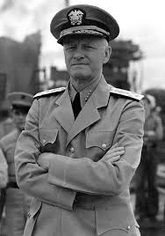
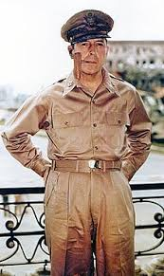
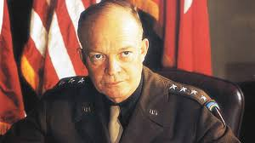
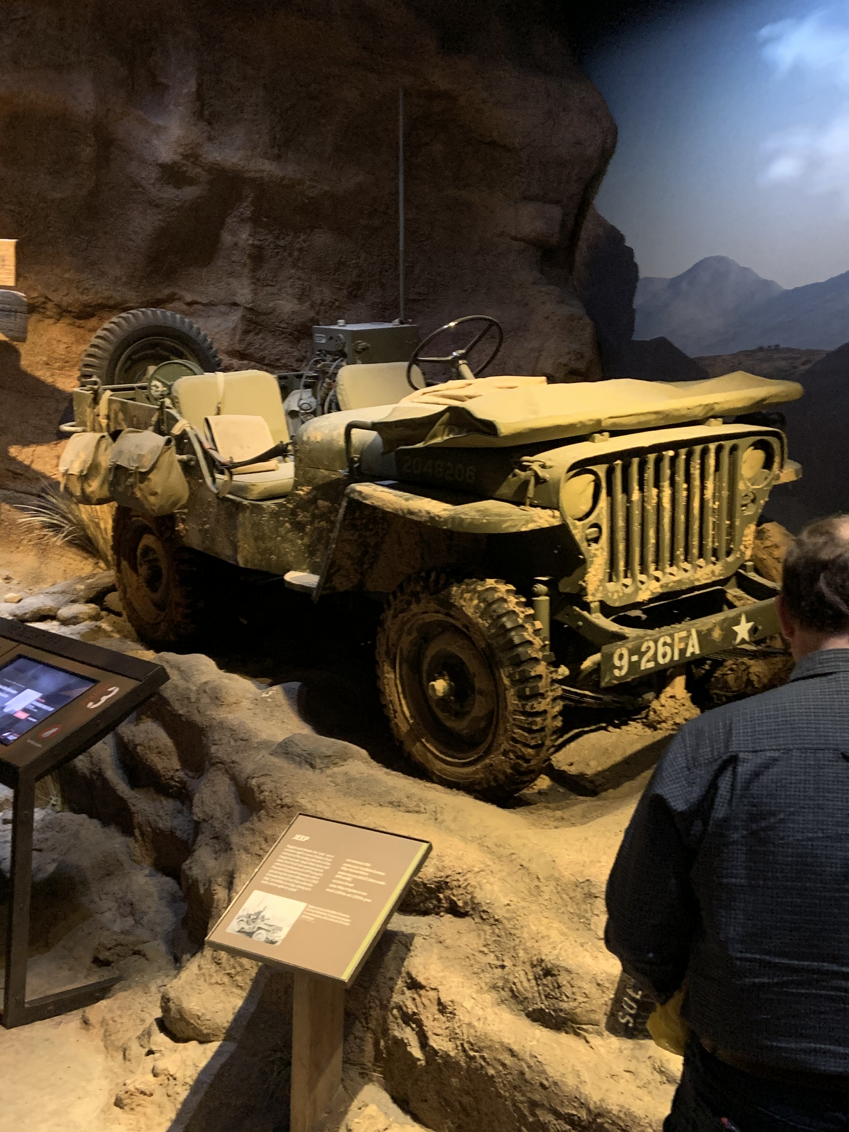
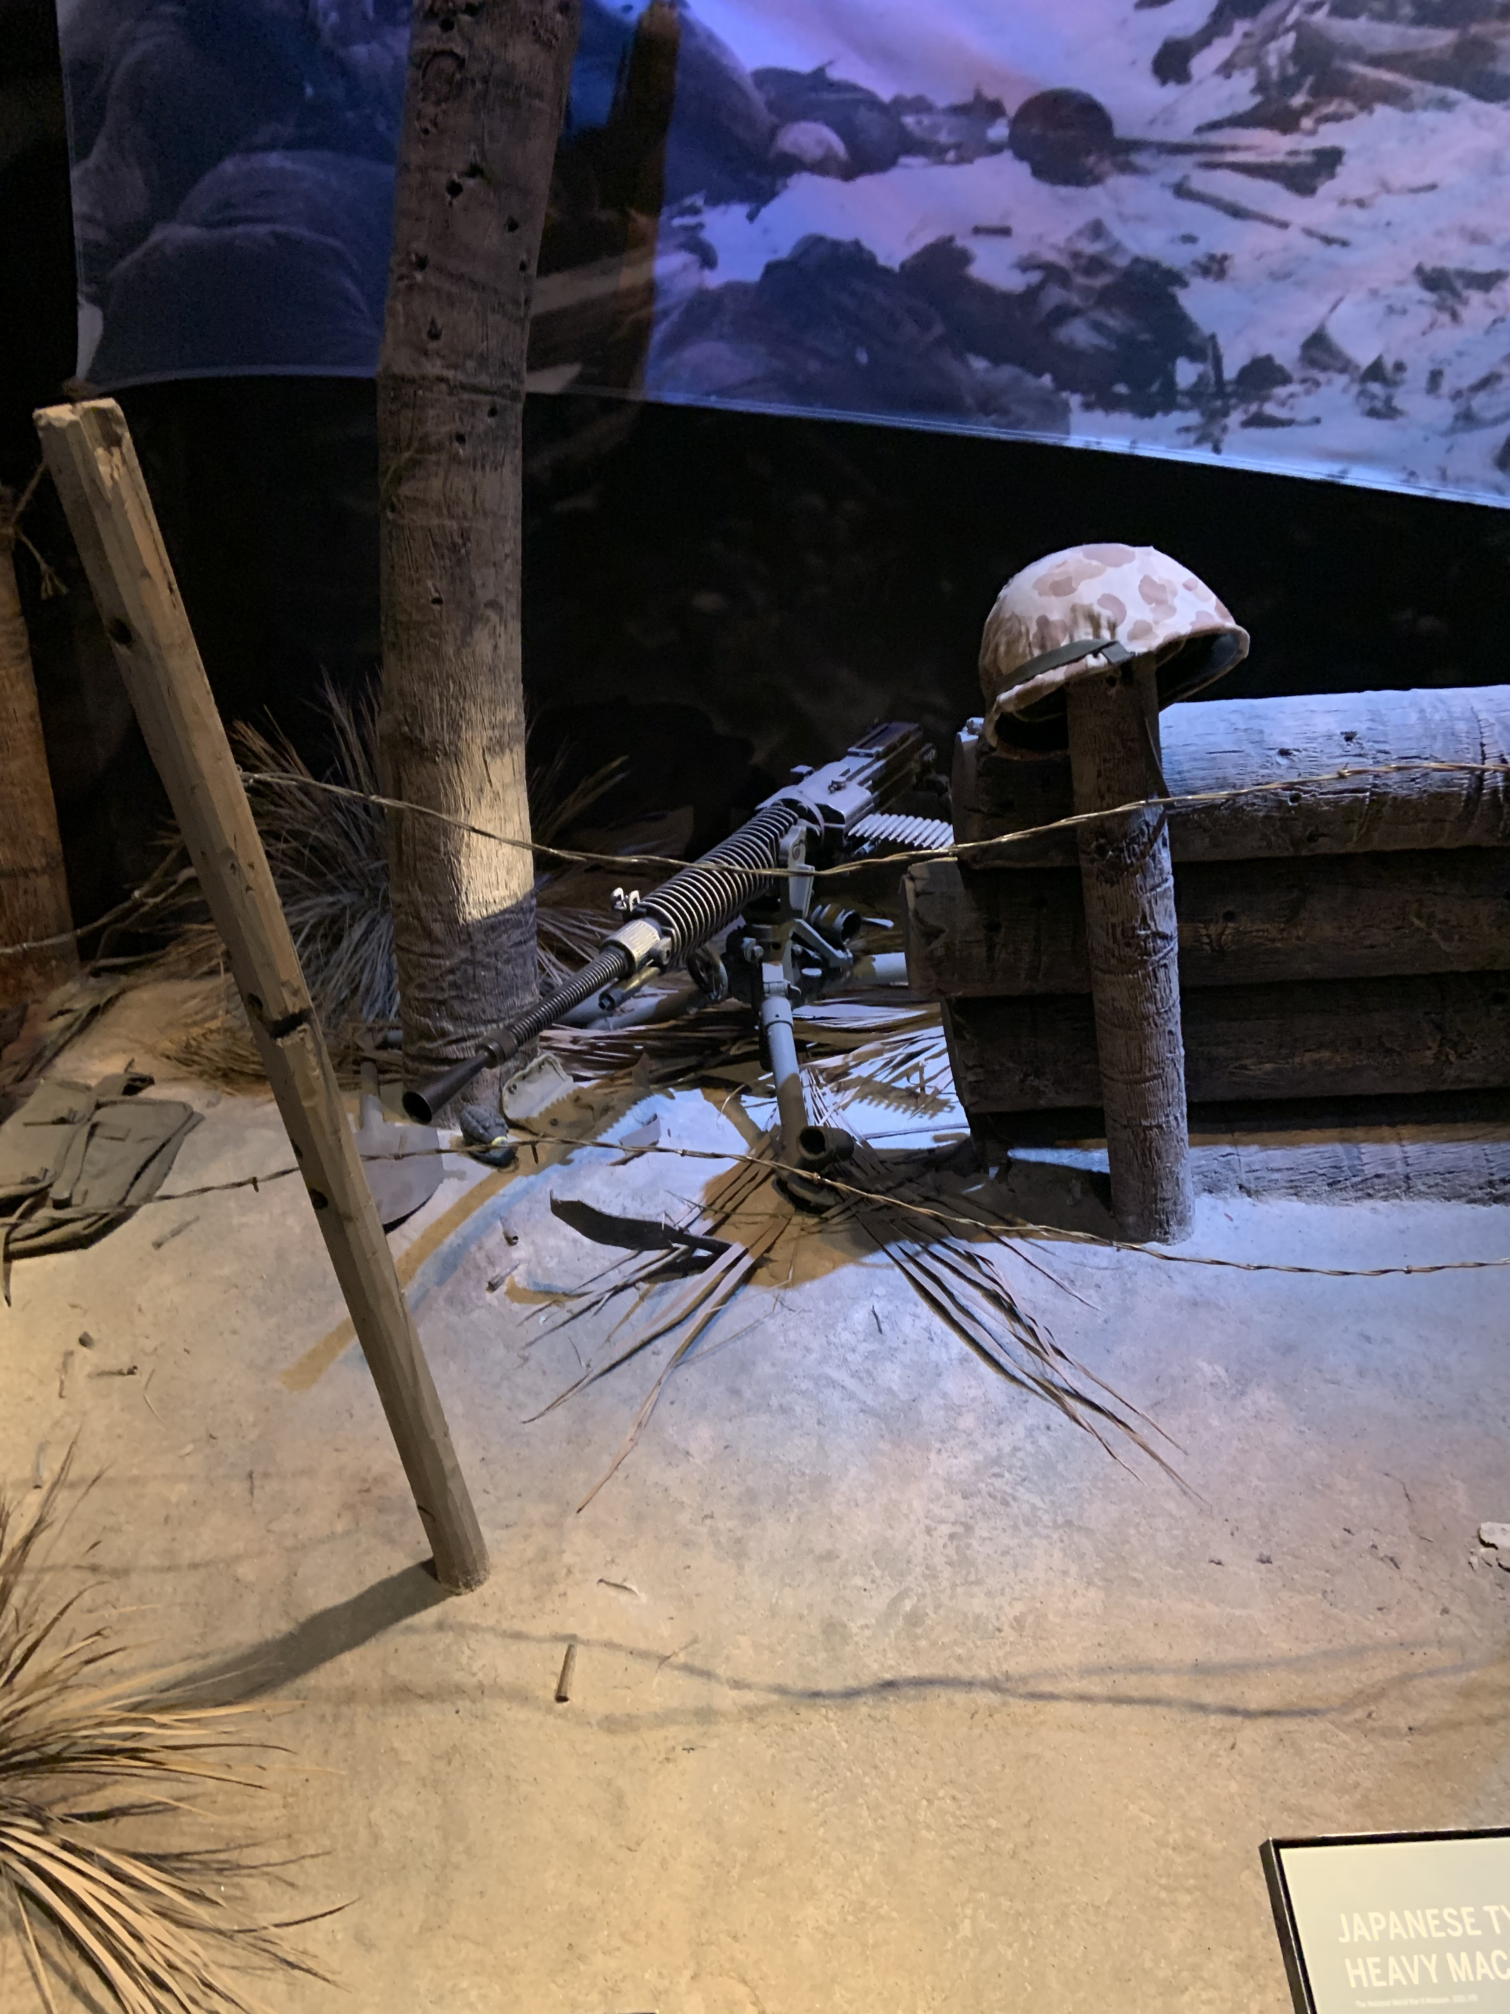
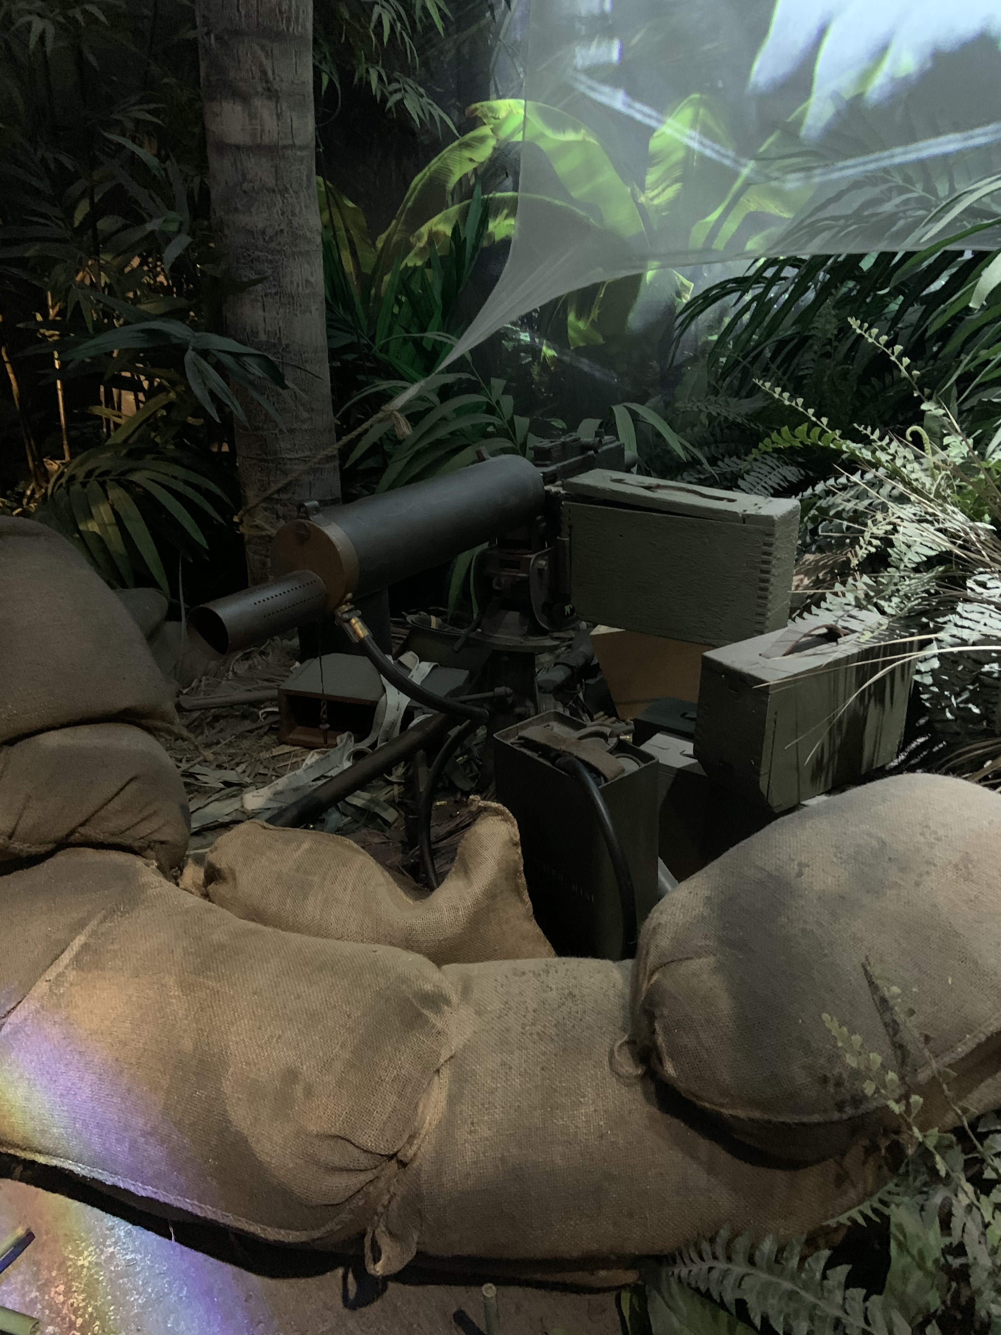
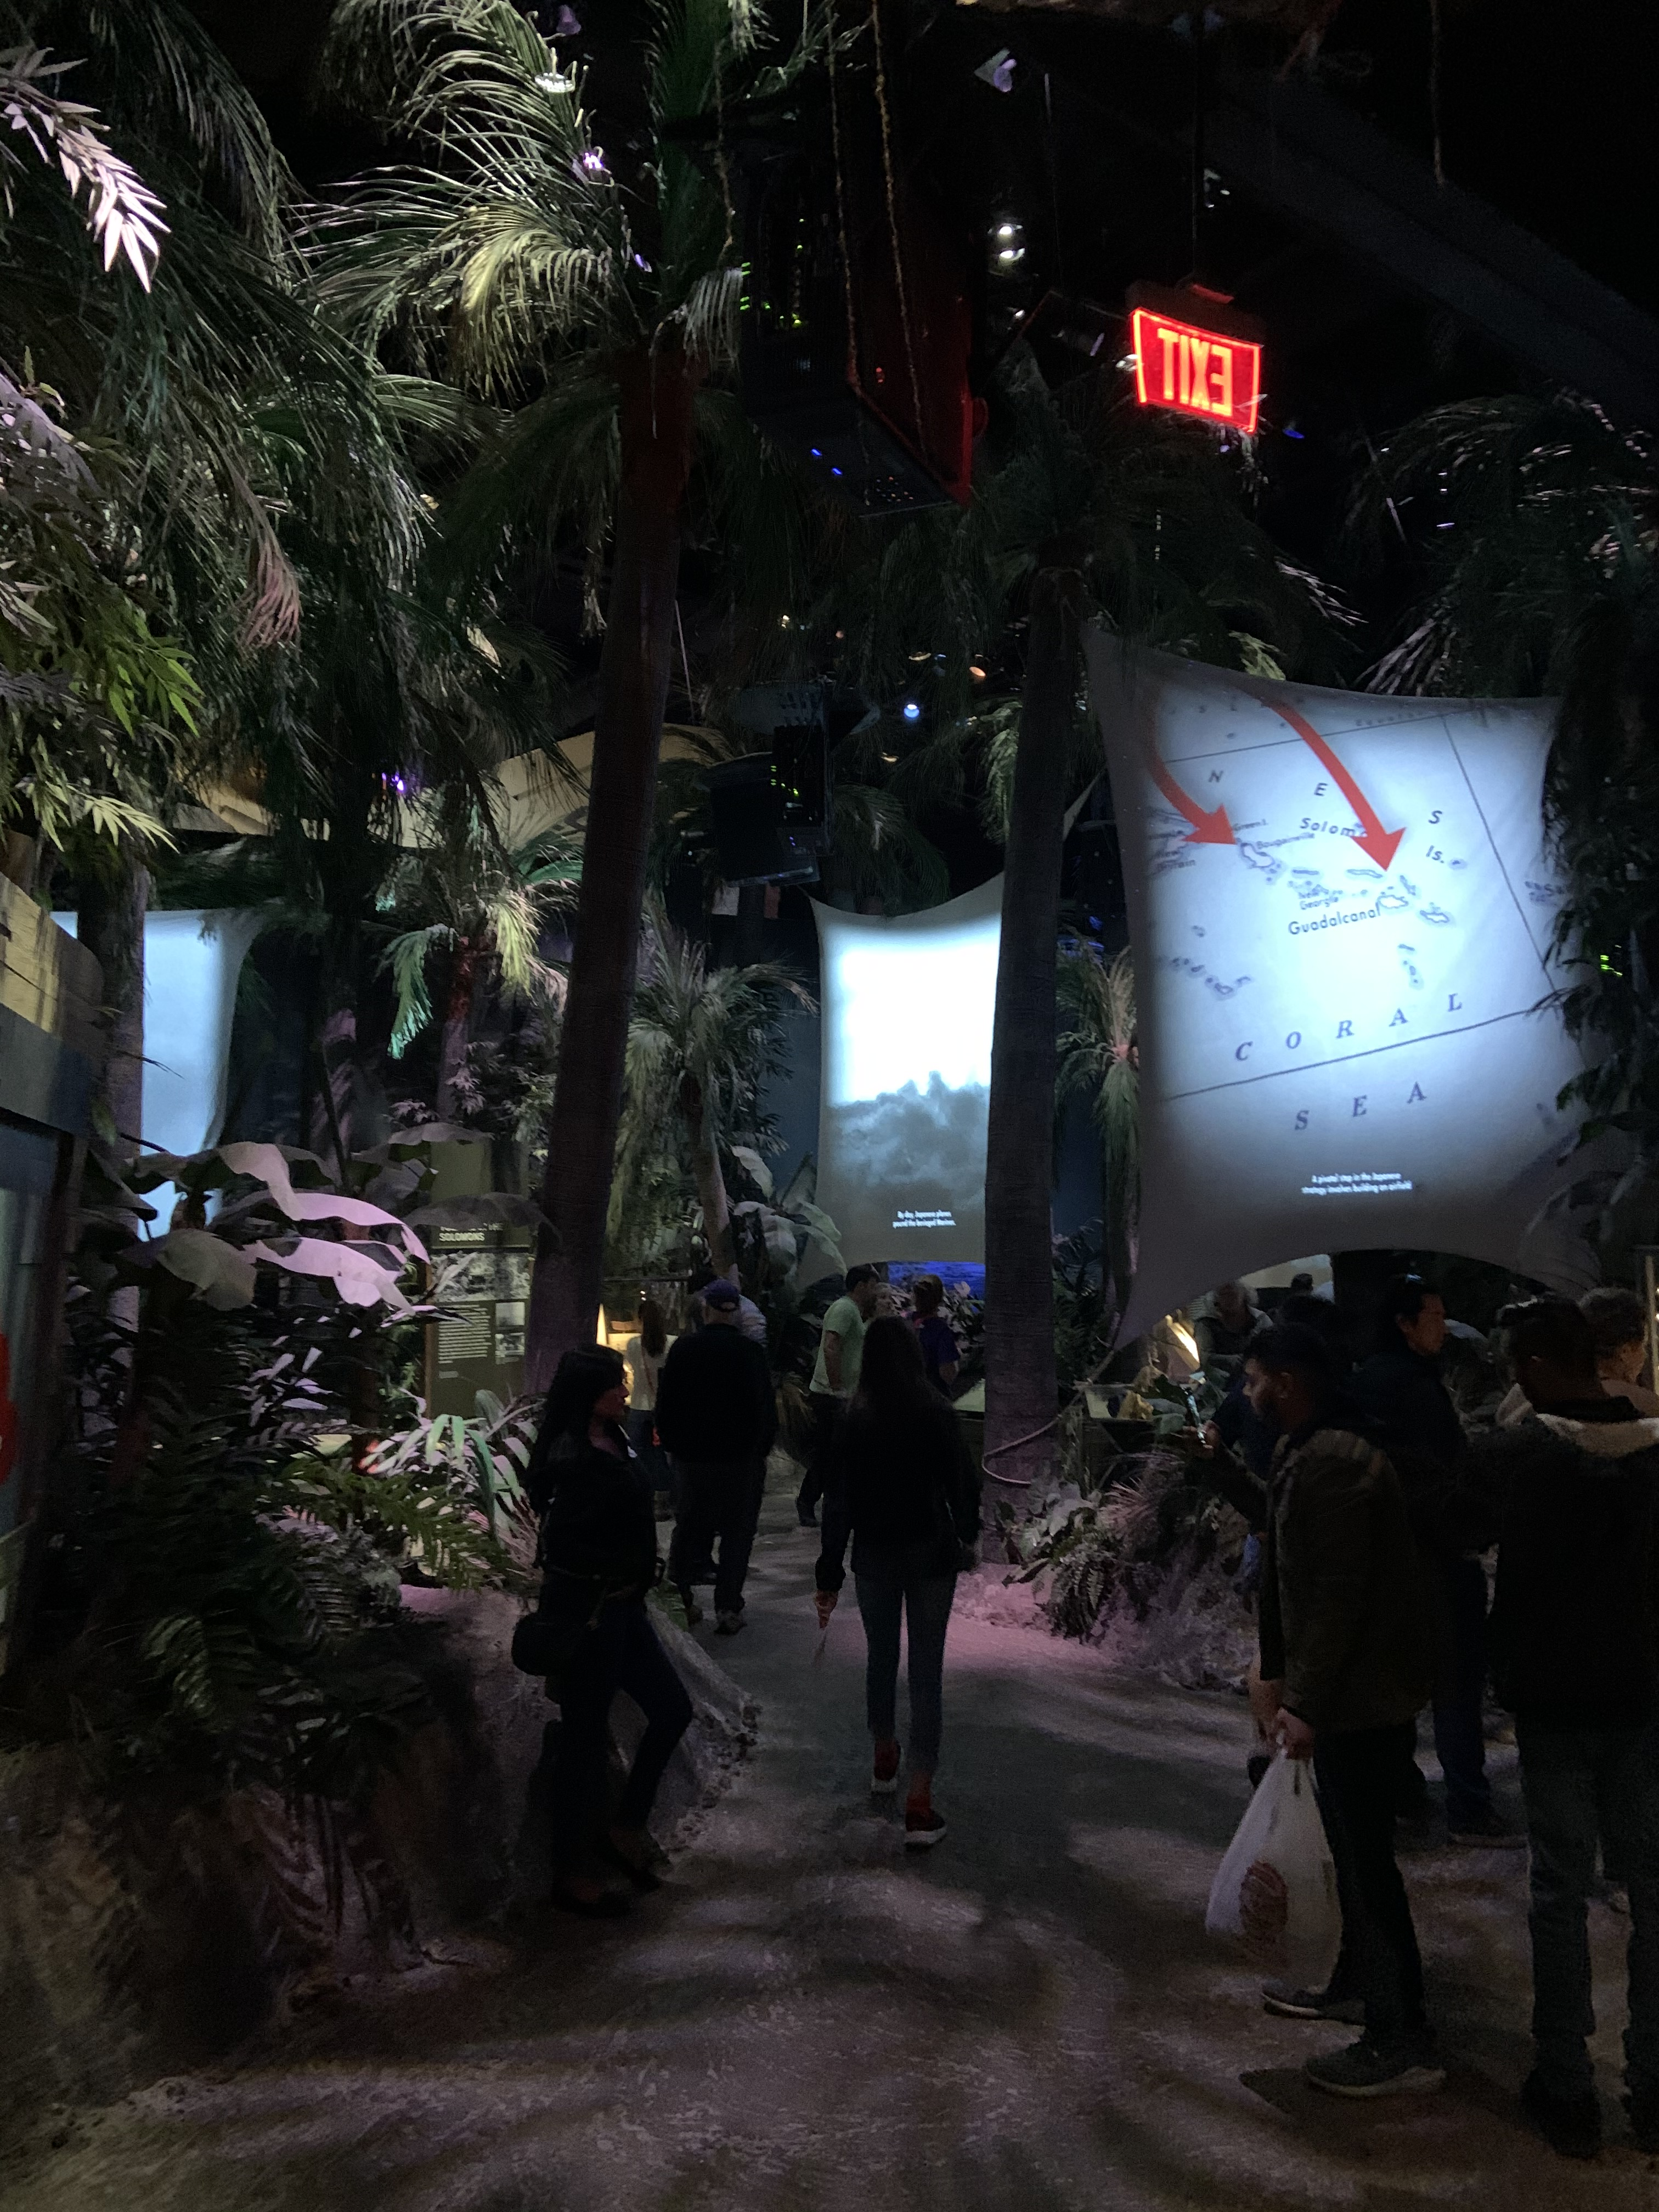
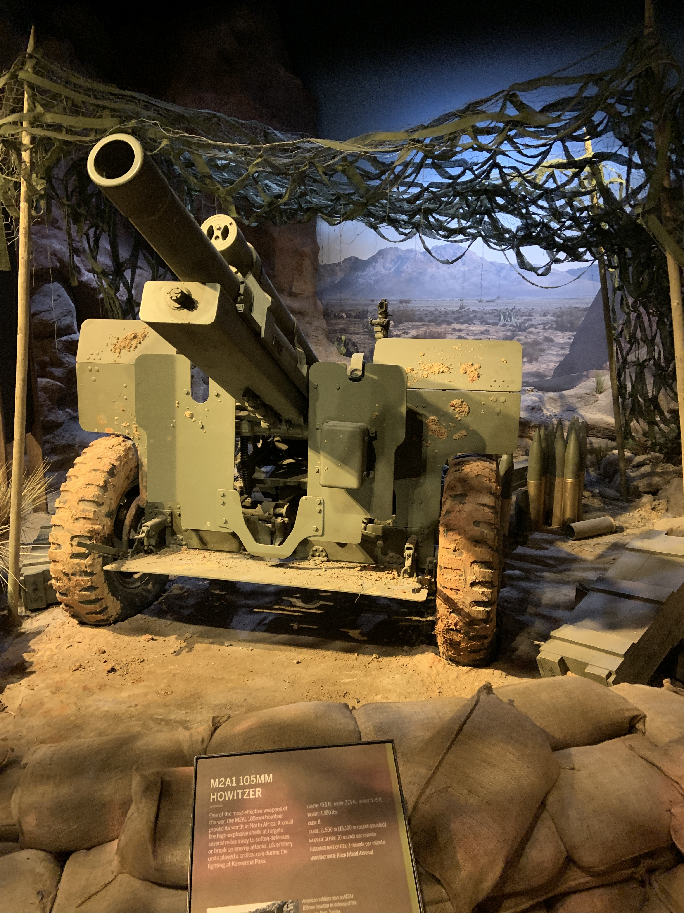
General Dwight D. Eisenhower
Admiral Chester Nimitz
General
Douglas MacArthur

