Slide 1
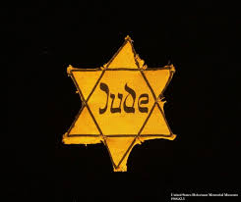
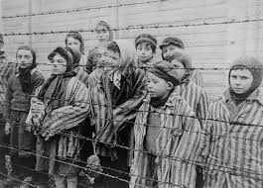
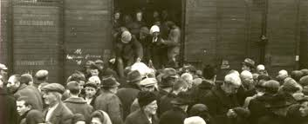
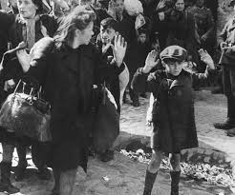
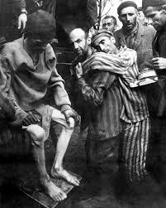
The Holocaust

Slide 2
What is the Holocaust?
The Holocaust was the systematic extermination (genocide) of the Jews.

Slide 3
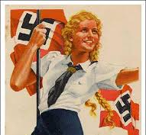
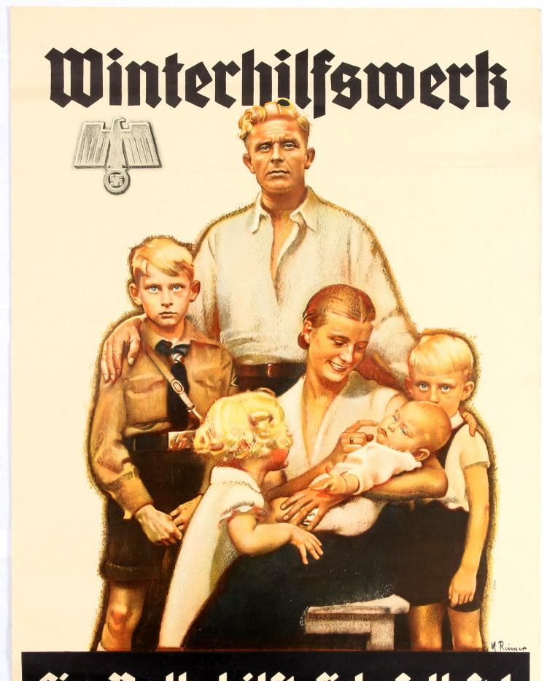
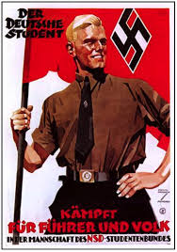
Hitler blamed the Jews for Germany’s defeat in WWI. He outlined his antisemitic views in his book “Mein Kampf.” Hitler and the Nazi Party Believed in a supreme, aryan race and he used propaganda to instill this idea in his followers.

Slide 4
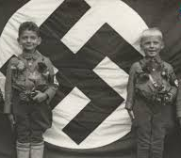
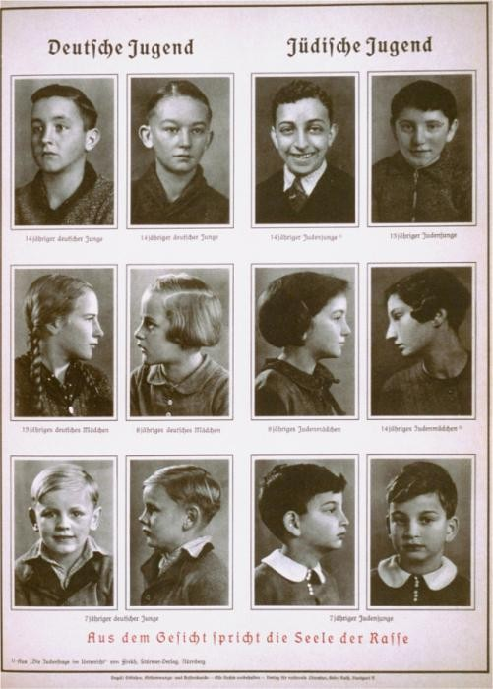
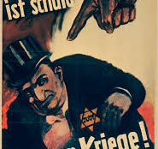
The Jews were not the only group of people who did not meet the criteria of Hitler’s Supreme Race. Other Groups of people Considered a threat to the Nazi regime included people with physical and mental disabilities, Gypsies, Poles, Afro-Germans, and Jehovah’s Witnesses. An extreme hatred of the Jews and the idea of a Supreme aryan race was instilled in Nazi men, women, and Children. The Hitler youth was taught Nazi Ideals at a young age with the goal of raising the next generation of Nazis.

Slide 5
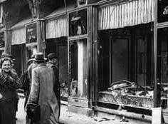
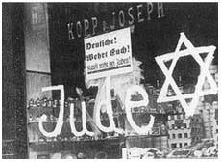
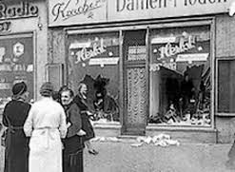
Germans strip Jews of their Citizenship and seize their property. Jews were forced to wear a yellow star of David so they were labeled as Jews in public. https://www.holocaustcenter.org/visit/library-archive/holocaust-badges/ On the “night of broken glass,” or Kristallnacht, many Jewish homes and businesses were destroyed.

Slide 6
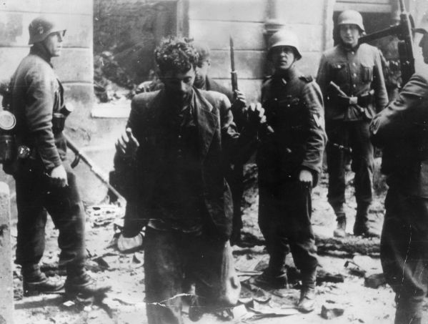
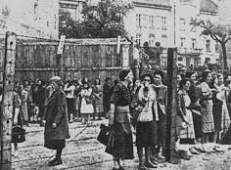
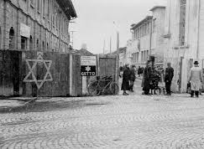
When Germany conquered huge sections of Europe and the Soviet Union early in World War II, nearly 10 million Jews came under Hitler’s control. The Nazis forced many Jews into ghettos. Ghettos were overcrowded, impoverished, and lacking medical care. Fighting back: in April 1943 Jews in the Warsaw ghetto staged a violent uprising, attacking the Germans with guns and homemade bombs. It took German troops nearly a month to crush the revolt. Survivors were sent to Treblinka.

Slide 7
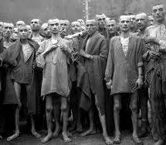
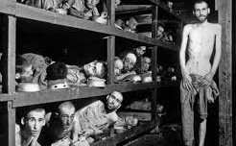
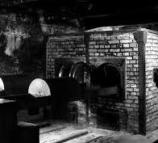
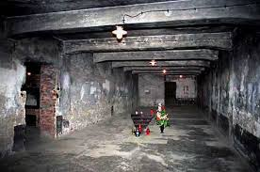
Hitler’s “final solution” was genocide, or the extermination of an entire group of people. Hitler built several death camps which contained gas chambers and crematoriums. The Nazis shipped millions of people to these camps. At the death camps most children, the elderly, and the sick were immediately executed. Those strong enough to work were used as laborers. When they became too ill to work, they were sent to the gas chambers.

Slide 8
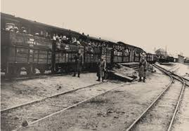
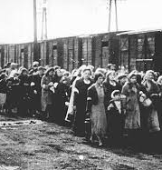
“When we got off the cattle truck, they ordered, ‘Men, right; women, left.’ . . . I went with my father. My little sister, Esther, she went with my mother. Esther was only eleven. She was holding my mother’s hand. When they made a selection of the women, Esther clung to my mother. My mother wouldn’t give her up. . . . They went straight to the gas chamber.” —Moritz Vegh, 13

Slide 9
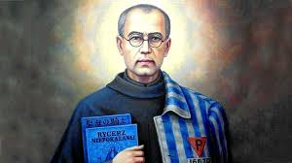
St. Maximilian Kolbe Maximilian Kolbe was a Polish Conventual Franciscan friar who volunteered to die in place of a stranger in the German death camp of Auschwitz, located in German-occupied Poland during World War II When a prisoner escaped late in July of that year, ten men from his barracks were picked to suffer death by starvation as both punishment and deterrent. Fr. Maximilian offered to take the place of one of the men; Franciszek Gajowniczek had let out a cry of pain for his family and this holy priest volunteered to take his place. He was Placed in a starvation bunker for three weeks and survived along with 3 other prisoners. They all died by lethal injection of carbolic acid. “no greater love than this, that a man lays down his life for his friend” (John 15:13). for there is “no greater love than this, that a man lays down his life for his friend”

Slide 10
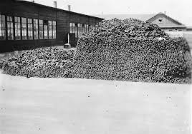
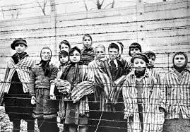
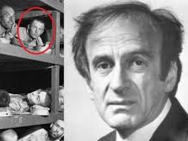
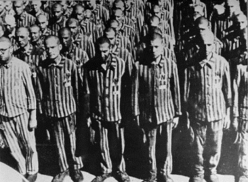
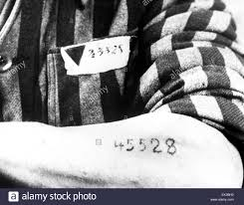

Slide 11
https://www.youtube.com/watch?v=fNpl83-rXKM https://www.youtube.com/watch?v=3JE4f-0lvuQ (3:11-3:15) https://www.youtube.com/watch?v=eNvY_GDK-Qk
Survivor Testimony

